Slide 1

Psychology 3488-001 – Psych Research & Statistics II
Psychology 3088-01L – Psych Research & Statistics II Lab
Lectures M/W/F 1:00-1:50 pm; Lab Fridays 2:00-3:15 pm
January to May 2020 in MODA 1A
COVID-19 ONLINE DELIVERY
Instructor: Dr. Mario Baldassari mbaldassari@tamusa.edu, @MarioBaldassari
Office hours Tues 2-3pm & 5-6pm, Fri 9-11am in STEM 237E (or by appt)
Please make an appointment ahead of time if you plan to visit office hours.

Slide 2
Date | Topic (reading) | Due | Also Due
23-Mar | 2-way and factorial ANOVA (Ch 11, 12)
30-Mar | Factorial ANOVA, main effects & interactions | Experiment ideas
6-Apr | No new topic, work on Test 3 | ANOVA worksheets
13-Apr | Nonparametric tests (Ch 13) | Test 3 | Experimental data
20-Apr | Single N Designs, Multiple regression, Reproducible Psy Sci (Ch 14) | Chi Square worksheet | Final paper Method section
27-Apr | How to choose a test, fill out an equation sheet (Ch 15) |  | Final paper Results section
8-May | Final exam date | Final exam | Final paper

Slide 3
How to decide which test to run
Identify aspects of design
  What are the IV/DV’s? How many IV’s?
  What are the levels of each IV?
  How are IV’s manipulated? Between s’s, within?
  What type of data is each IV/DV? Nominal, ordinal, ratio, scale?
Know which aspects lead to which stat test
  What is H0?
  What is H1?
  How to arrive at p and write decision sentence
Read chapter 15, it’s a good one
I have a worksheeeeet!

Slide 4
One Sample Compared To Population
Ratio, Interval, ~Ordinal
Nominal Data
Know μ and σ
Know μ; not σ
Chi-Square Goodness
Of Fit Test
z-test
t-test

Slide 5
Difference Between Two Samples
Between-Subjects
Within-Subjects
Ratio/Interval
Ordinal
Nominal
Ratio/Interval
Ordinal
Independent-
Samples t-test
Mann-Whitney
Test
Chi-Square Test
For Independence
Paired-
Samples t-test
Wilcoxon
Test
Notes:
MW and Wilcoxon offered for completeness, not part of exam

Slide 6
Difference Between More Than Two Samples
One Independent Variable
Between-subjects
Within-subjects
Ratio/Interval
Ordinal
Nominal
Ratio/Interval
Ordinal
One Factor
Independent Samples
ANOVA
Kruskal-Wallis
Test
Chi-Square Test
For Independence
One Factor
Repeated Measures
ANOVA
Friedman
Test
Post-hoc Tests
Sidak; Tukey; Etc.
Post-hoc Tests
Sidak; Tukey; Etc.
Notes:
KW and Friedman also for completeness, not on exam

Slide 7
Difference Between More Than Two Samples
Two or More Independent Variables
All IVs Between-subjects
All IVs Within-subjects
Some B/S; Some W/S IVs
Ratio/Interval
Ratio/Interval
Ratio/Interval
Multifactor
Independent-Samples
ANOVA
Multifactor
Repeated Measures
ANOVA
Mixed Factor
ANOVA
Post-hoc Tests
Sidak; Tukey; Etc.
Post-hoc Tests
Sidak; Tukey; Etc.
Post-hoc Tests
Sidak; Tukey; Etc.

Slide 8
Relationship (Correlation) between Two Variables
Correlation
Ratio/Interval
Ordinal
Nominal
Pearson
Correlation
Coefficient
Spearman
Correlation
Coefficeint
At least one
ordinal; other
ratio/interval
Phi-Coefficient
(dichotomous)
or
Point Biserial
Notes:
None of this on test

Slide 9
An equation sheet

Slide 10
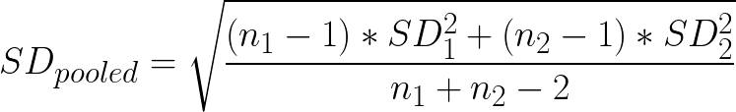




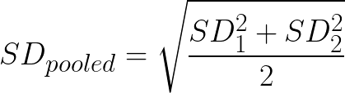


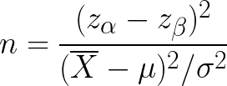


___
___
___
___
___
___
___
___
___
___
___
___
= 1- β
___
Notes:
Yikes!

Slide 11
For independent-groups t-tests

Slide 12
For Cohen’s d of an independent-groups t-test,
assume N’s are same, so SDpooled simplifies

Slide 13
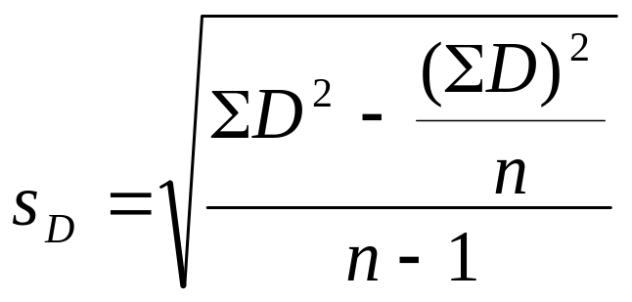
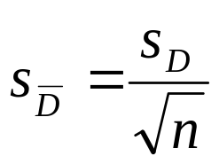
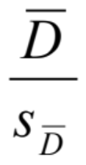
For repeated-measures t-tests
Dbar = (sum of D’s) / N
t_{obs} =

Slide 14

For one-sample t-test Confidence Intervals
When pop sd is known:
When pop sd is unknown:

Slide 15

For Power of a one sample t-test
β = area beyond z
power = 1- β
When you are shooting for a level of power and want to find the sample size necessary…
Can simplify if you recognize denominator…

Slide 16
df_{TOTAL} = N-1, df_{BW} = k-1, df_{WI} = N-k
df_{TOTAL} = df_{BW} + df_{WI}
Any Mean Square = relevant SS/df
F = MS_{BW}/MS_{WI}
For a one-way independent-groups ANOVA

Slide 17
One-way repeated-measures ANOVA
SS_{TOT} = SS_{TREAT} + SS_{SUBJECTS} + SS_{TREATMENT X SUBJECTS}
df_{TOT} = N – 1, df_{TREAT} = k – 1, df_{SUBJECTS} = N – k
ALSO df_{TOT} = df_{TREATMENT} + df_{SUBJECTS}
df_{TxS} = (k-1)(k_{ps}-1)
F = MS_{TREATMENT} / MS_{TREAT X SUBJ}

Slide 18

Post Hoc Tests
Tukey’s HSD
(MS in denominator switches to MS_{TxS} for a rm-ANOVA)
Bonferroni alpha level correction
α / # of tests

