Slide 1

PSYCH 2202 – The Psychology Major
M/W 2:00-2:50 pm
January to May 2020 in STEM 231A
COVID-19 ONLINE DELIVERY
Instructor: Dr. Mario Baldassari mbaldassari@tamusa.edu, @MarioBaldassari
Office hours Tues 2-3pm & 5-6pm, Fri 9-11am in STEM 237E (or by appt)
Please make an appointment ahead of time if you plan to visit office hours.

Slide 2
Date | Topic (reading) | Due | Also Due
23-Mar | Bem discussion, using memory research | Bem reflection | Upload your presentation paper
30-Mar | A&M Degree plan advice, career services
6-Apr | No lecture, spend week watching presentations | Article presentation slides, audio, questions
13-Apr | Simmons et al (2011) | Reflection 2
20-Apr | Problems in Psych (NYT & 538 PDF's) | Presentation quiz
27-Apr | Myths about working with a psych degree | Your future presentation slides, audio, questions
11-May | Final exam date | Presentation quiz, Final Reflection Paper, take final exam

Slide 3
Now that you’ve read some psychology…
Let’s talk about methodology.
R&M I & II are packed, hard to find room for some issues
Psych has changed dramatically in the last 10 years
Notes:
Now that you’ve read some published, peer-reviewed psychological science, we have a nice opportunity to talk about scientific methodology again. You’ll of course cover these topics very deeply in Research Methods & Stats I and II, but those courses are so packed with critical information that it can be hard for instructors to find room for some issues in our literatures. Primary among these, to me, is a change that psychology has been dealing with for about 10 years.

Slide 4
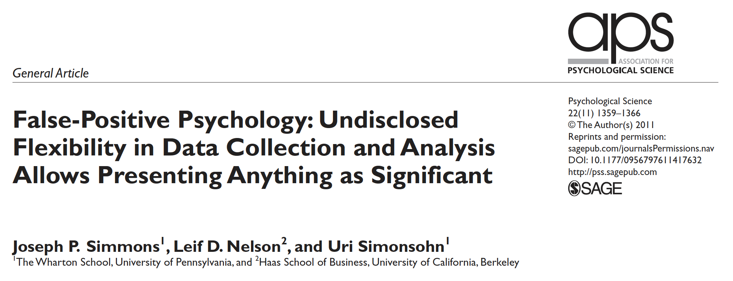
Notes:
So today: The concepts of false positives in psychological research and researcher degrees of freedom. False positives are particularly dangerous in science (moreso than false negatives) because they can be hard to refute. Imagine you ran a test and found that a drug worked. How many additional tests in which it didn’t work would you need to run to conclude that your first test was just an error? In the abstract, we might say only a few, but in the real world it’s tougher to say. People all over the world might find that the drug doesn’t work, but have no way to tell each other, because scientific journals typically only publish papers about drugs that work. I know! Dangerous!
At the same time that refuting a false-but-already-made claim is difficult to do, that claim is being used in practice. The drug that we saw work once is being used! This is potentially dangerous in some situations, and is undoubtedly wasteful in all.
So it is a good idea for us to reduce false positives as low as we can. In psychology, we adopt statistical rules such that we believe only 5% of our positive results are false. Simmons, Nelson, and Simonsohn will show through simulations here that the actual rate of false positive results in psychology is far higher

Slide 5
Researcher degrees of freedom (decisions)
Should more data be collected?
Should some observations be excluded?
Which conditions should be combined and which ones compared?
Which control variables should be considered?
Should specific measures be combined or transformed or both?
Etc.
Notes:
The reason our false positive rate is higher than our stated value of 5% is due to the many decisions researchers make as they go along a project. The authors call these researcher degrees of freedom, and they note that these items should all be answered before researchers begin a project but often are not
Go through questions
People aren’t doing this to cheat the system, in fact until recently it was recommended practice! The suggestions made by Bem in the article you read previously suggest that you fiddle with many of these things. The authors present the example of outliers, for which there really aren’t hard-fast rules for how to deal with them, so researchers can fiddle!

Slide 6
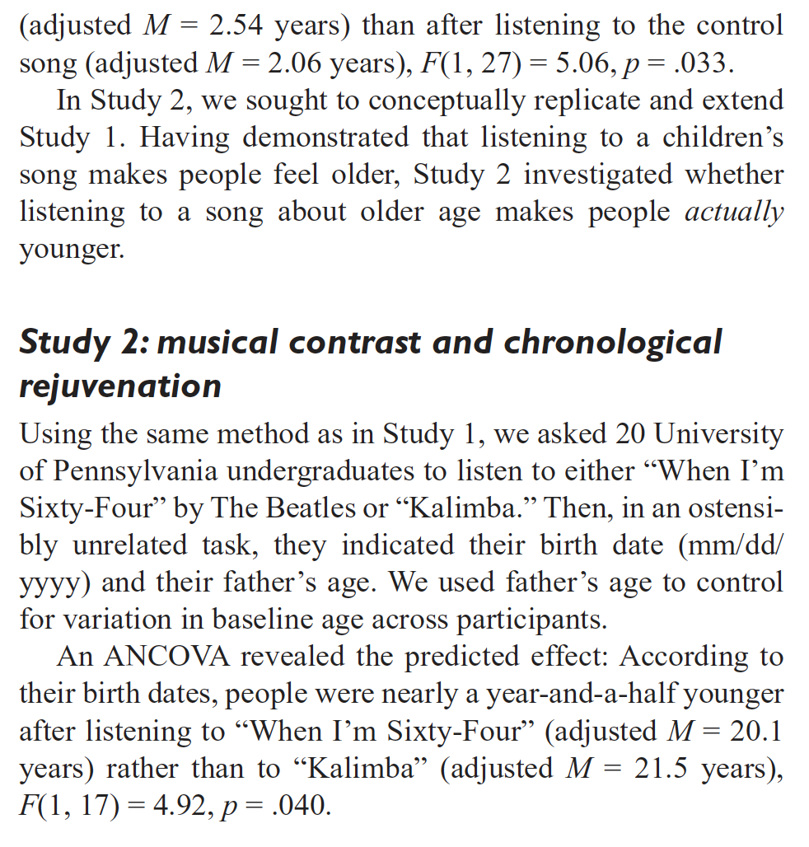
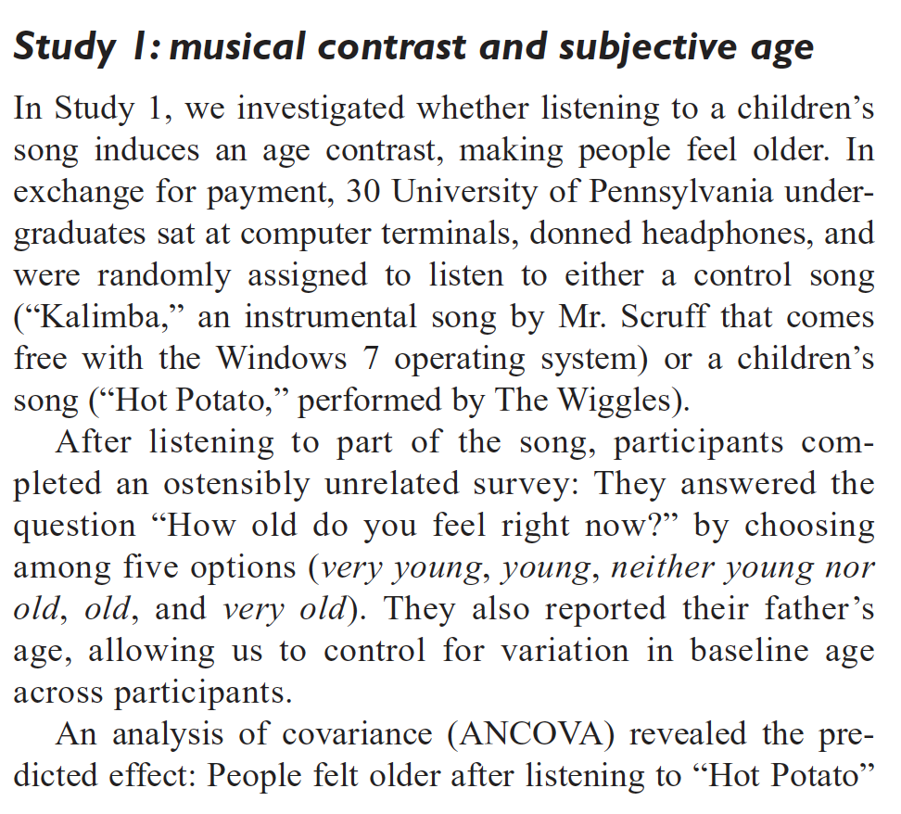
The Studies
Notes:
Completed with real participants and legitimate statistical methods, but come up with results that are unlikely and impossible
But how?? Through careful use of researcher degrees of freedom

Slide 7
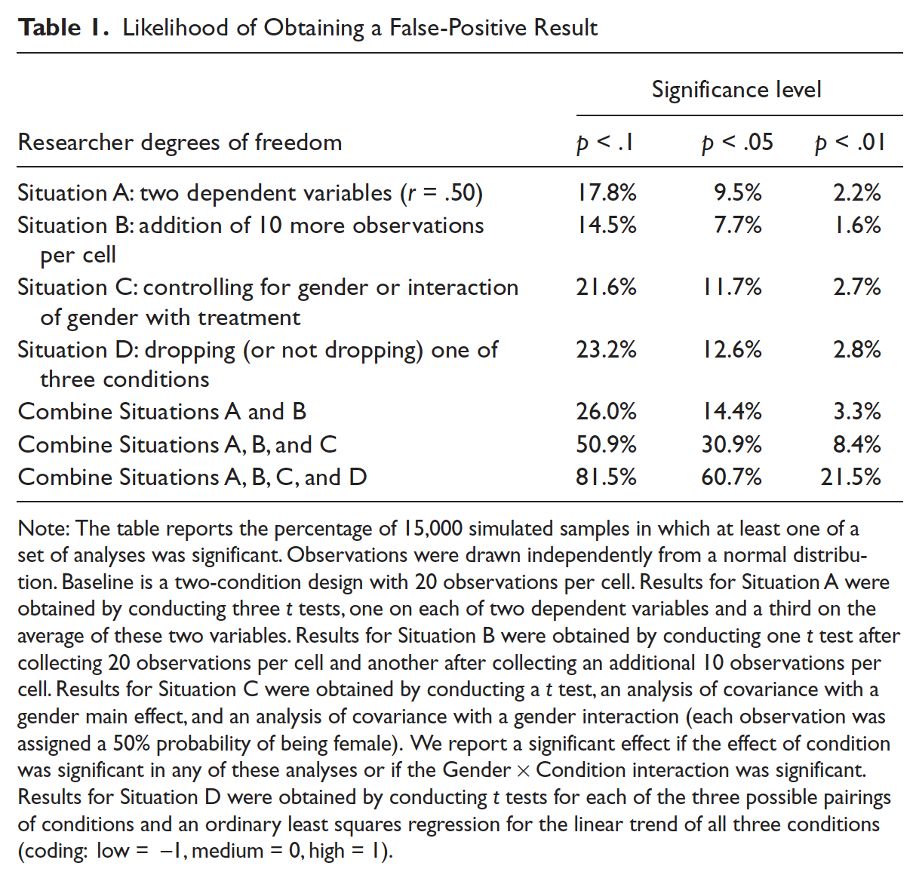
Notes:
Table 1 from the paper: a list of researcher degrees of freedom and their influence on likelihood to obtain a statistically significant result
These simulations assessed
the impact of four common degrees of freedom: flexibility in
(a) choosing among dependent variables, (b) choosing sample
size, (c) using covariates, and (d) reporting subsets of experimental
conditions. We also investigated various combinations
of these degrees of freedom.
We generated random samples with each observation independently
drawn from a normal distribution, performed sets of
analyses on each sample, and observed how often at least one
of the resulting p values in each sample was below standard
significance levels. For example, imagine a researcher who
collects two dependent variables, say liking and willingness to
pay. The researcher can test whether the manipulation affected
liking, whether the manipulation affected willingness to pay,
and whether the manipulation affected a combination of these
two variables. The likelihood that one of these tests produces
a significant result is at least somewhat higher than .05. We
conducted 15,000 simulations of this scenario (and other scenarios)
to estimate the size of “somewhat.”2

Slide 8
Notes:
The
first row shows that flexibility in analyzing two dependent
variables (correlated at r = .50) nearly doubles the probability
of obtaining a false-positive finding.3
The second row of Table 1 shows the results of a researcher
who collects 20 observations per condition and then tests for
significance. If the result is significant, the researcher stops
collecting data and reports the result. If the result is nonsignificant,
the researcher collects 10 additional observations per
condition, and then again tests for significance. This seemingly
small degree of freedom increases the false-positive rate
by approximately 50%.
The third row of Table 1 shows the effect of flexibility in
controlling for gender or for an interaction between gender
and the independent variable.4 Such flexibility leads to a falsepositive
rate of 11.7%. The fourth row of Table 1 shows that
running three conditions (e.g., low, medium, high) and reporting
the results for any two or all three (e.g., low vs. medium,
low vs. high, medium vs. high, low vs. medium vs. high) generates
a false-positive rate of 12.6%.

Slide 9
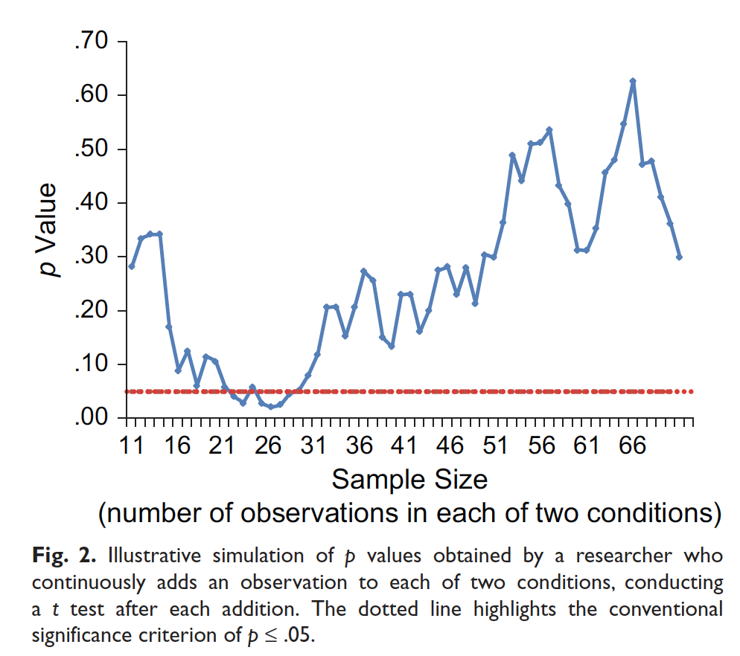

Slide 10
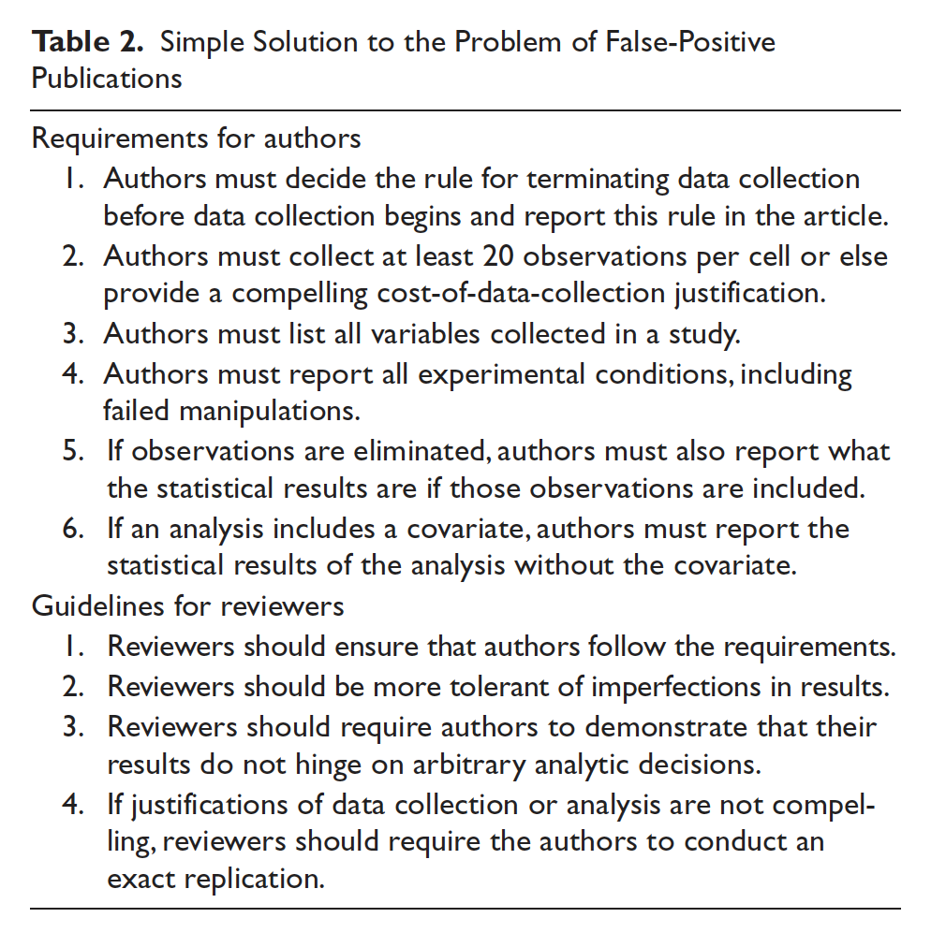

Slide 11
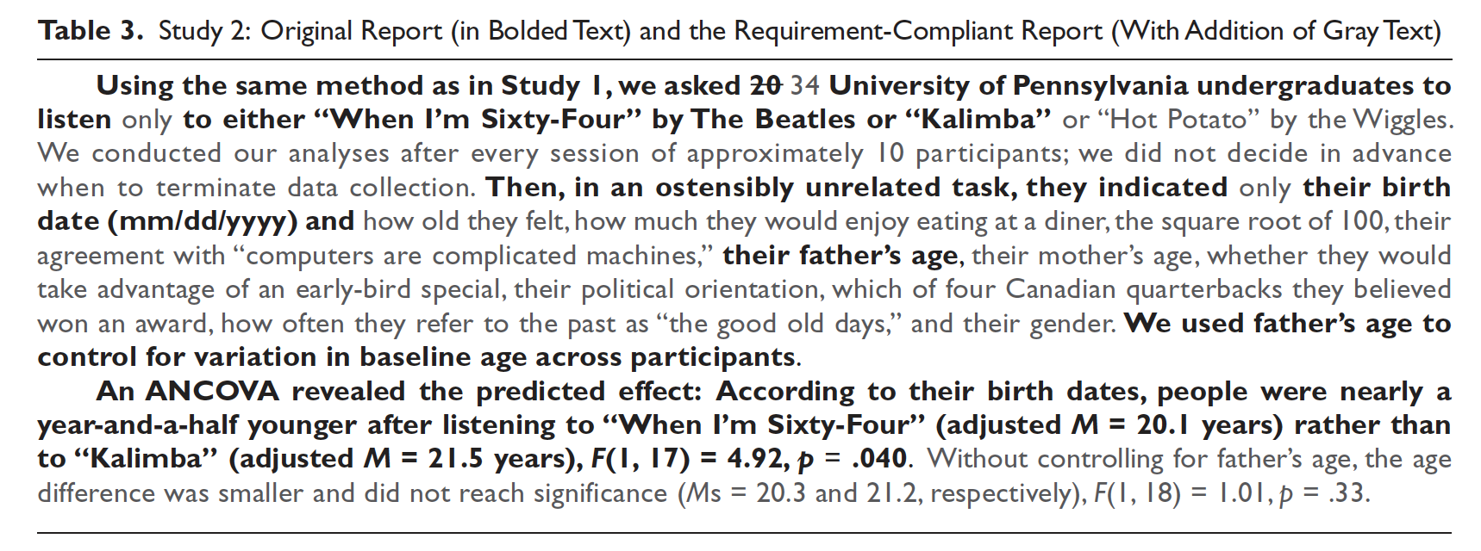

Slide 12
