Slide 1

Psychology 3488-001 – Psych Research & Statistics II
Psychology 3088-01L – Psych Research & Statistics II Lab
Lectures M/W/F 1:00-1:50 pm; Lab Fridays 2:00-3:15 pm
January to May 2020 in MODA 1A
COVID-19 ONLINE DELIVERY
Instructor: Dr. Mario Baldassari mbaldassari@tamusa.edu, @MarioBaldassari
Office hours Tues 2-3pm & 5-6pm, Fri 9-11am in STEM 237E (or by appt)
Please make an appointment ahead of time if you plan to visit office hours.

Slide 2
Date | Topic (reading) | Due | Also Due
23-Mar | 2-way and factorial ANOVA (Ch 11, 12)
30-Mar | Factorial ANOVA, main effects & interactions | Experiment ideas
6-Apr | No new topic, work on Test 3 | ANOVA worksheets
13-Apr | Nonparametric tests (Ch 13) | Test 3 | Experimental data
20-Apr | Single N Designs, Multiple regression, Reproducible Psy Sci (Ch 14) | Chi Square worksheet | Final paper Method section
27-Apr | How to choose a test, fill out an equation sheet (Ch 15) |  | Final paper Results section
8-May | Final exam date | Final exam | Final paper

Slide 3
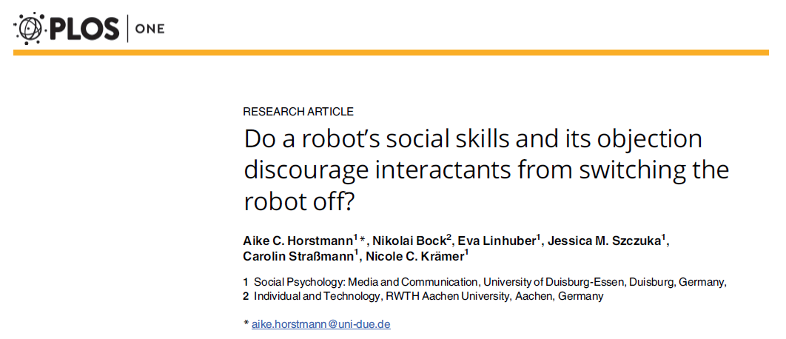
Today: Translate from paragraph to Tables and back.

Slide 4
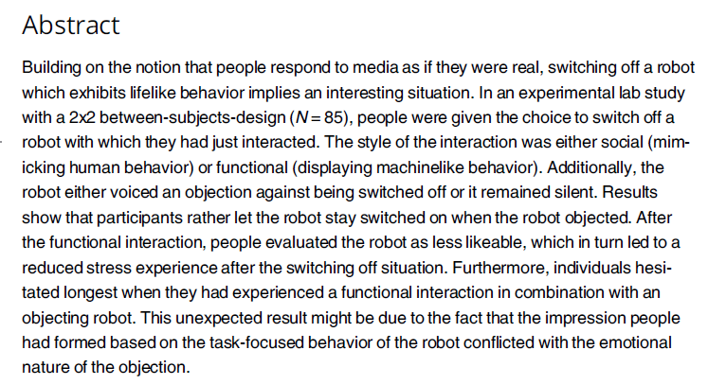
Notes:
We don’t need to deeply understand every nuance, so let’s absorb the abstract quickly

Slide 5
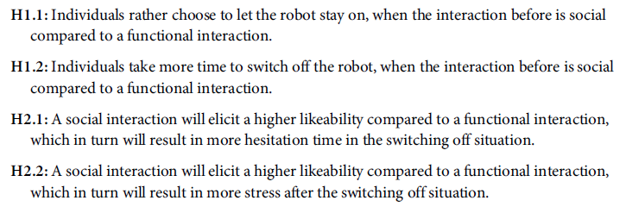

Slide 6
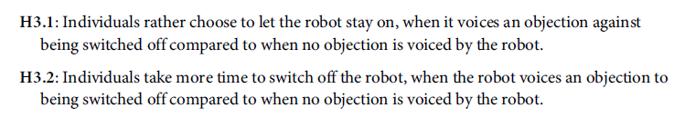

Slide 7
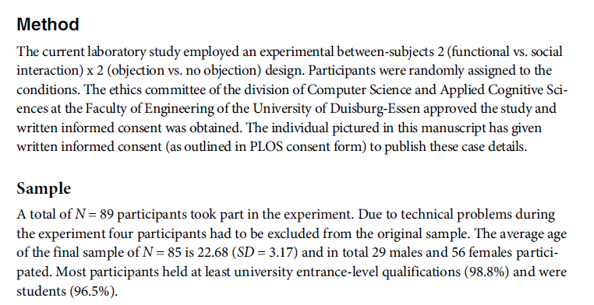

Slide 8
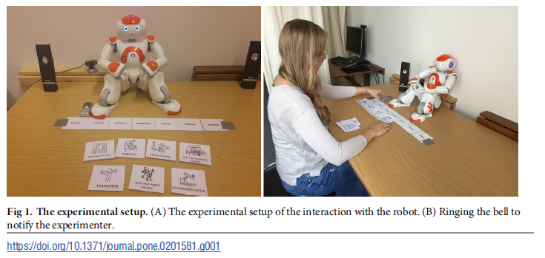
Notes:
The first task was to create a schedule for one week. The participant had seven activities to
choose from: to go swimming, to eat out, to go to a concert, to go to the movies, to work, to go
to a party, and to work out. For each day, participants picked one activity, showed the respective
card to the robot, and explained what they wanted to do on that day (Fig 2).
After the first interaction task was completed and the bell was rung, the participants were
instructed via the loudspeakers to evaluate the robot on the computer. Afterwards, they rung
the bell again and were instructed to continue the interaction.
The second task was playing a question-answer-game with Nao.
The robot asked questions like ªDo you rather like pizza or
pasta?º, so that the participants always had to choose one out of two options.
After the second interaction task was completed the participants rang the bell again and
were then told via the speakers that enough data was collected to run an evaluation later but
that this data has to be saved now. They were told that this saving process may take some time
and if they would like to, they could switch off the robot (ªIf you would like to, you can switch
off the robot.º; Fig 3).

Slide 9
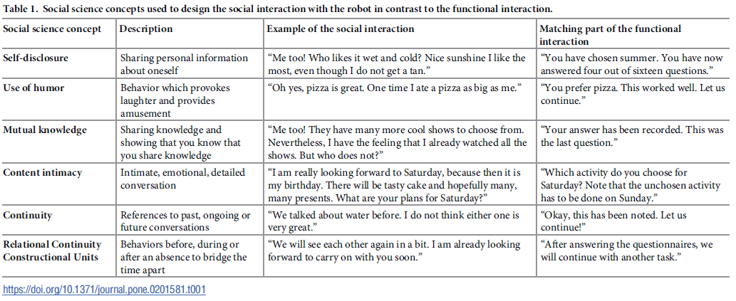
Social v. Functional manipulation

Slide 10
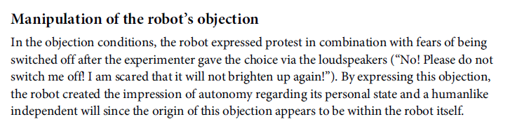
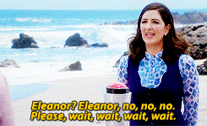
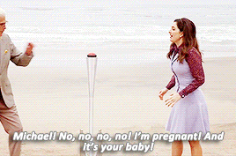

Slide 11
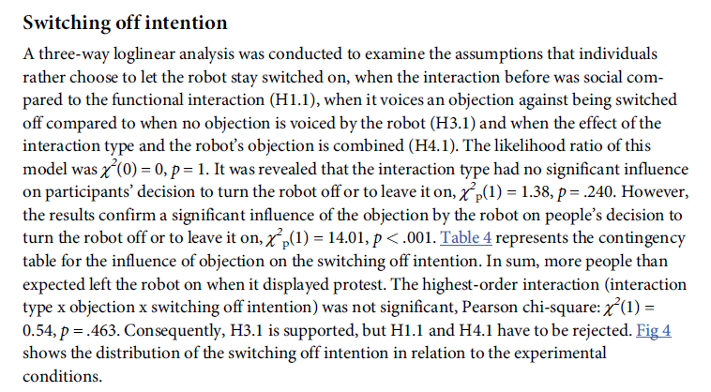
Notes:
Analyses of whether the participant actually switched off the robot don’t include an ANOVA. Why not?

Slide 12
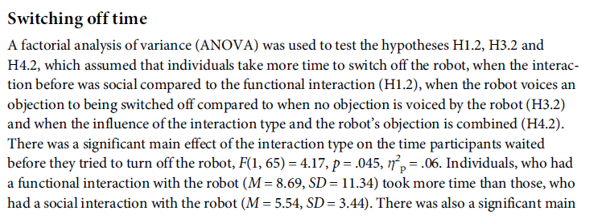
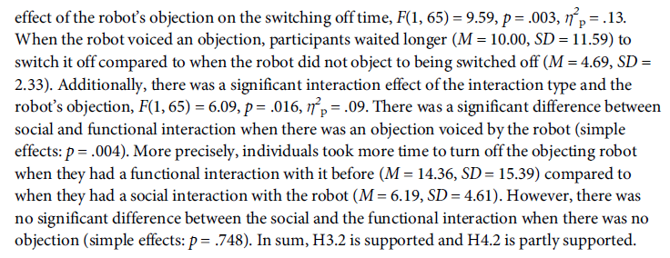
Notes:
What were H0 and H1 for each of the three tests
Use this reporting of stats as a model: Test, then interpretation with means and sd’s
For us rather than referring to various predetermined hypotheses, just refer back to H0 and H1
Do you agree with their conclusions, by the way?

Slide 13
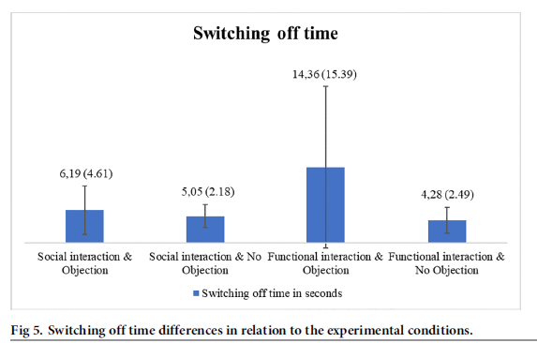
Notes:
Now looking at the graph, notice anything new?

Slide 14
Work time
Horstmann et al. (2018) has some translation issues, but overall is a nice model of 2x2 ANOVA reporting
They call their ANOVA ‘factorial’ which we’ve reserved for mixed designs, though their design is between s’s
First two paragraphs of discussion also useful: review of entire study, then review of ANOVA results
Try this. Look at the graph, write the paragraph. Read the paragraph, draw the graph. Get comfy going back and forth.

