Slide 1

Psychology 3488-001 – Psych Research & Statistics II
Psychology 3088-01L – Psych Research & Statistics II Lab
Lectures M/W/F 1:00-1:50 pm; Lab Fridays 2:00-3:15 pm
January to May 2020 in MODA 1A
COVID-19 ONLINE DELIVERY
Instructor: Dr. Mario Baldassari mbaldassari@tamusa.edu, @MarioBaldassari
Office hours Tues 2-3pm & 5-6pm, Fri 9-11am in STEM 237E (or by appt)
Please make an appointment ahead of time if you plan to visit office hours.

Slide 2
Date | Topic (reading) | Due | Also Due
23-Mar | 2-way and factorial ANOVA (Ch 11, 12) | Experiment ideas
30-Mar | Factorial ANOVA, main effects & interactions | Experimental data
6-Apr | ANOVA examples & worksheets | 2-way ANOVA worksheet
13-Apr | Nonparametric tests (Ch 13) | Test 3
20-Apr | Single N Designs, Multiple regression, Reproducible Psy Sci (Ch 14) | Chi Square worksheet | Final paper Method section
27-Apr | How to choose a test, fill out an equation sheet (Ch 15) |  | Final paper Results section
8-May | Final exam date | Final exam | Final paper

Slide 3

A kick-off note: Science may not be a signal detection problem
As noted at Psychonomics 2019 by John Wixted
We seek p
Argues we should seek to accurately estimate d

Slide 4
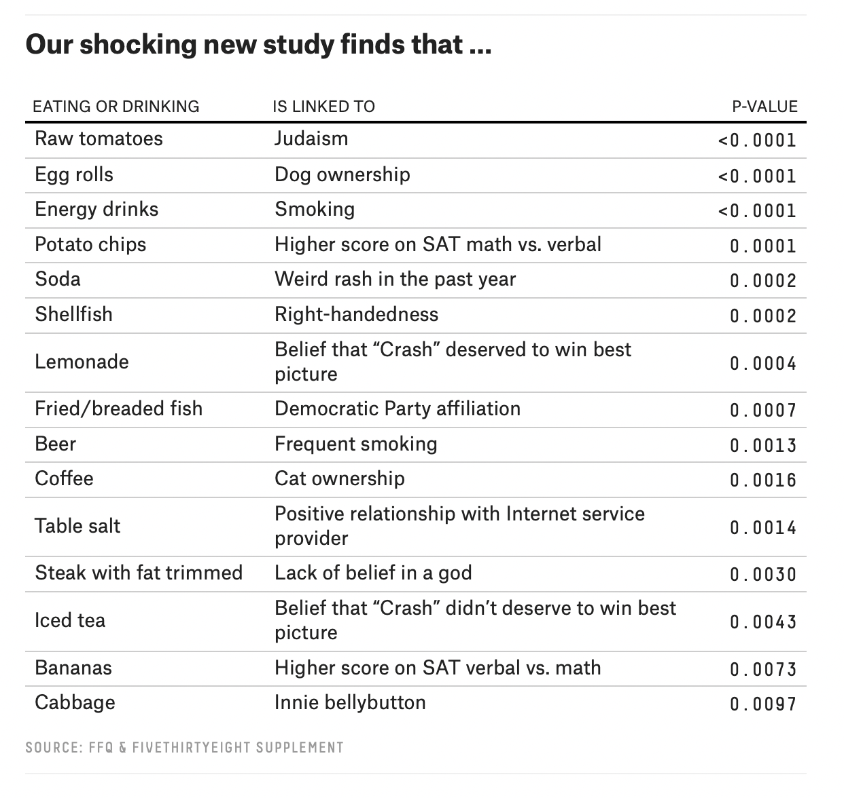
https://fivethirtyeight.com/features/you-cant-trust-what-you-read-about-nutrition/
Notes:
Part of the reason is that they probably are finding lots of spurious correlations
For two reasons
when you have tons of data, things are bound to pop up as related
When you look at thousands of possible relationships, odds are good you’ll find at least one
Might be some in pop media confusing correlation with causation, also

Slide 5
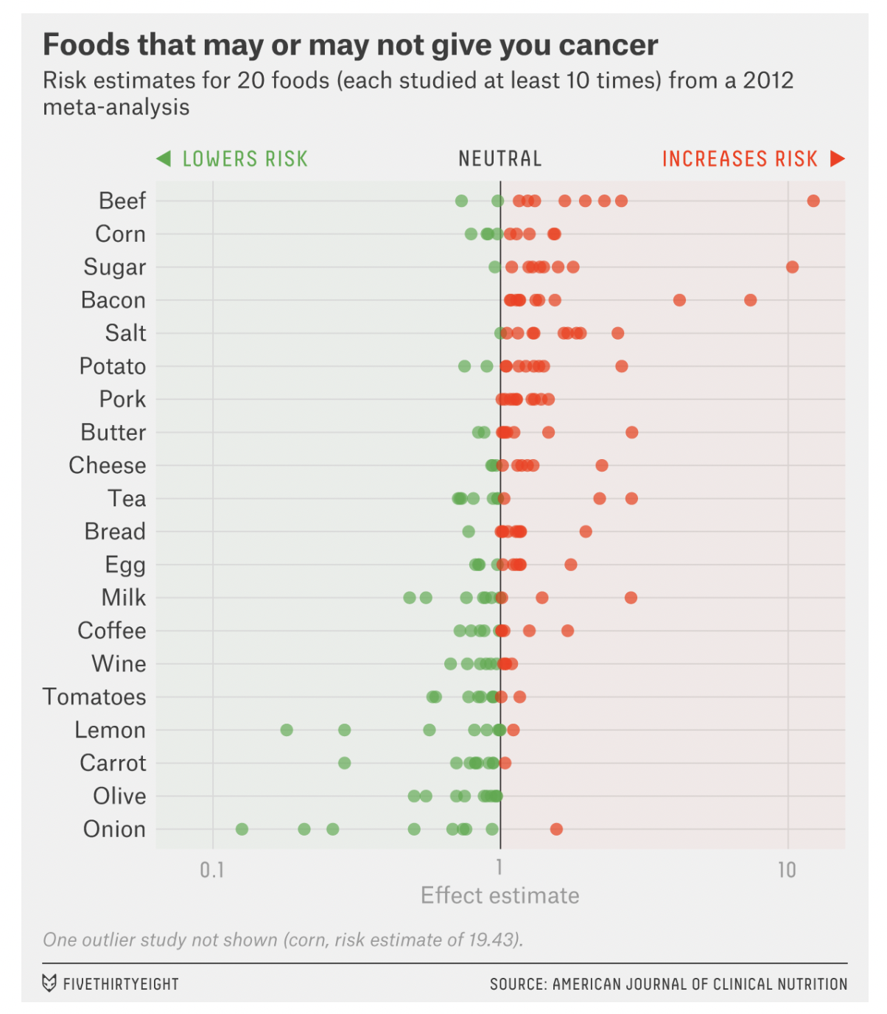
Notes:
Warm up: Diet research has been all over the place. Why?

Slide 6
Learning outcomes
By the end of this class, you will be able to…
Approach published psychological science with a skeptical eye toward contemporary understandings of open and pre-registered methodology
Recognize the importance of sample size, representativeness, replications, refereed journals, and some of the mediocre science that has been done in psych in the past

Slide 7

Is HPV Vaccine Life Threatening?
14-year-old girl dies hours after receiving HPP vaccine. (2009)
Autopsy revealed a malignant tumour in Natalie Morton’s heart and lungs.
It would be an odd world in which no child who recently received a vaccine could die. If two events are independent then they are likely sometimes to co-occur (with a probability that is the product of the individual probabilities).

Slide 8
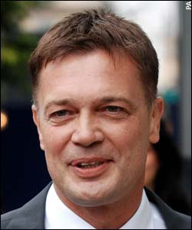
Does the Mumps/Measles Vaccine Cause Autism?
Wakefield published a study of 12 UK children diagnosed with developmental delays (8 with autism) after receiving measles/mumps/rubella vaccine.
At time of study, 90% of UK children received MMR vaccine, usually around 1 to 2 years of age.
Developmental delays are rarely diagnosed before a child is at least 1 or 2.
Ergo almost all children diagnosed with devel delays would have received the MMR vaccine, even though MMR has zero causal influence on developmental delays.
Andrew Wakefield

Slide 9


Does Red Wine Promote Heart Health?
Tim Stockwell, UVic’s Centre for Addiction Research BC
Many studies have observed that individuals who have a few drinks of alcohol per week have lower rates of heart disease and other maladies than those who do not drink alcohol.
In North America and Europe, a substantial percentage of individuals who do not drink alcohol avoid it because they are alcoholics in recovery or because they have other maladies. Evidence for benefits of alcohol not clear when this is taken into account.

Slide 10

Does Praying Together Promote Staying Together?
“Couples of Who Pray Together Stay Together”
Globe and Mail
Implication is that prayer has a causal effect on relationship stability. That could be true, but there are a variety of other plausible interpretations of the correlation.

Slide 11
Do Vitamin D Supplements Reduce Cancer Risk?
The correlation is real. But it is not clear whether having higher D prevents cancer or having or being vulnerable to cancer lowers D.
Randomized, prospective, double-blind, placebo-controlled experiments have so far not strongly supported the idea that vitamin D supplements lower cancer risk.
Few if any adverse effects of supplements up to 2,000 units and its cheap but little reason to believe it will lower cancer risk.

Slide 12
How Decide How Much Confidence to Have in a Claim that X has a Causal Influence on Y?
Intuition, casual observation
Authority
Science
  Combination of logic/mathematics and rigorous empirical observation
  Web of Science, Library and sites
Even so, a problem: Some “science” is more rigorous than other “science.”

Slide 13
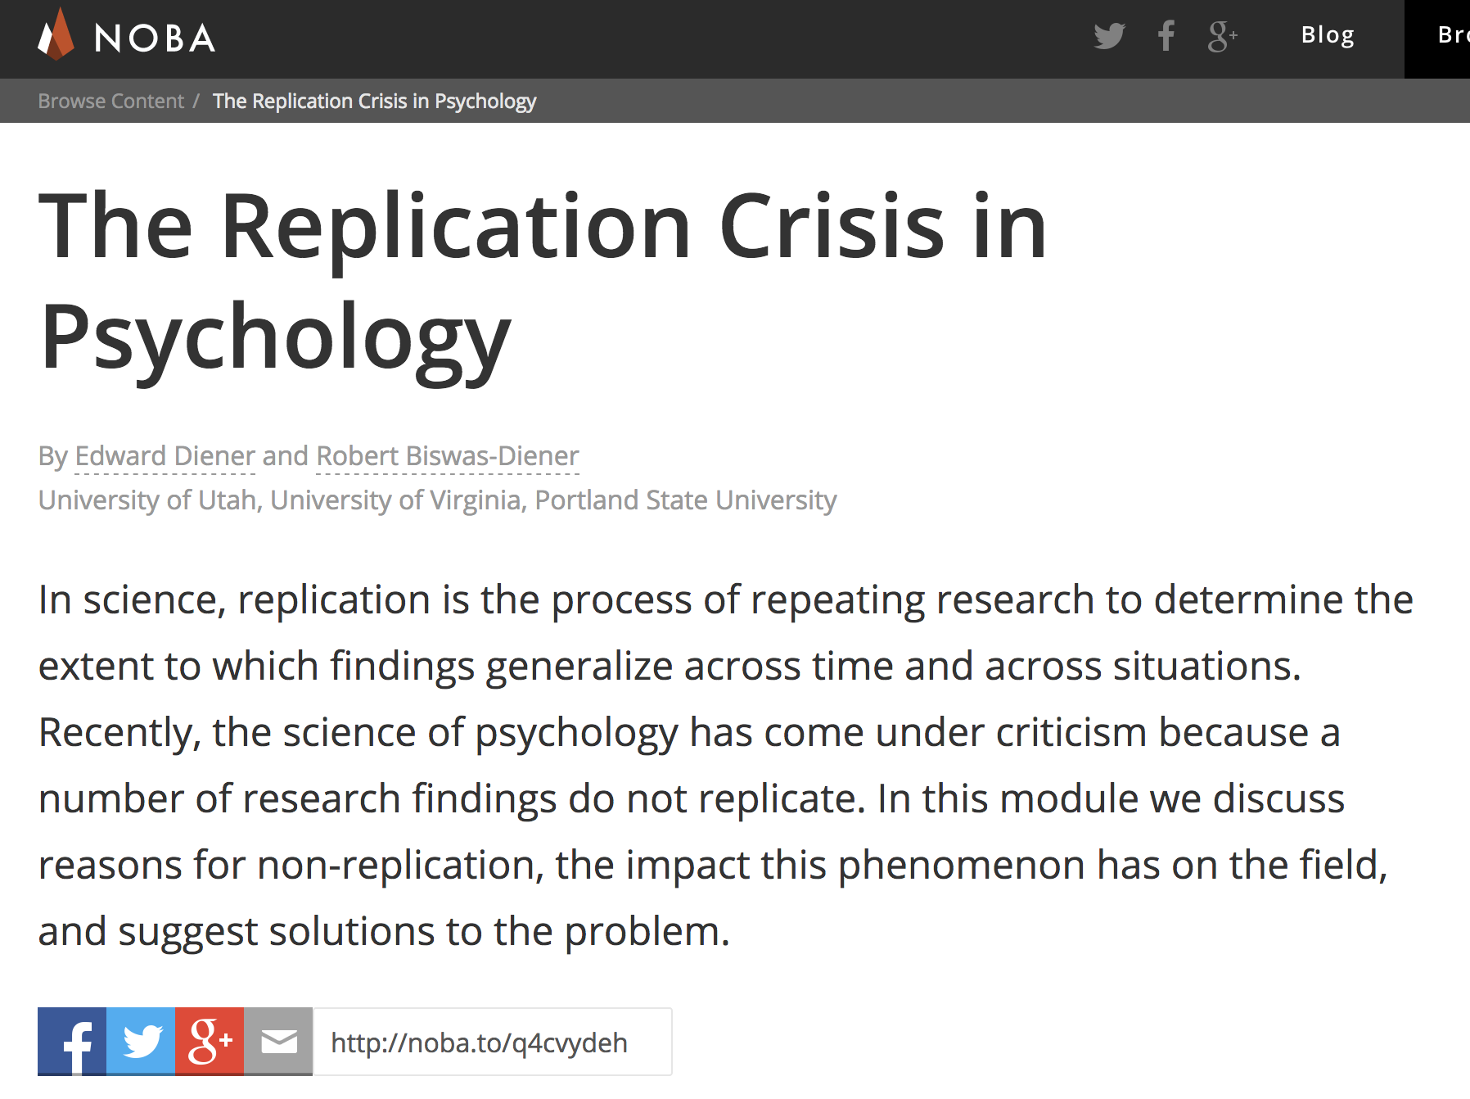
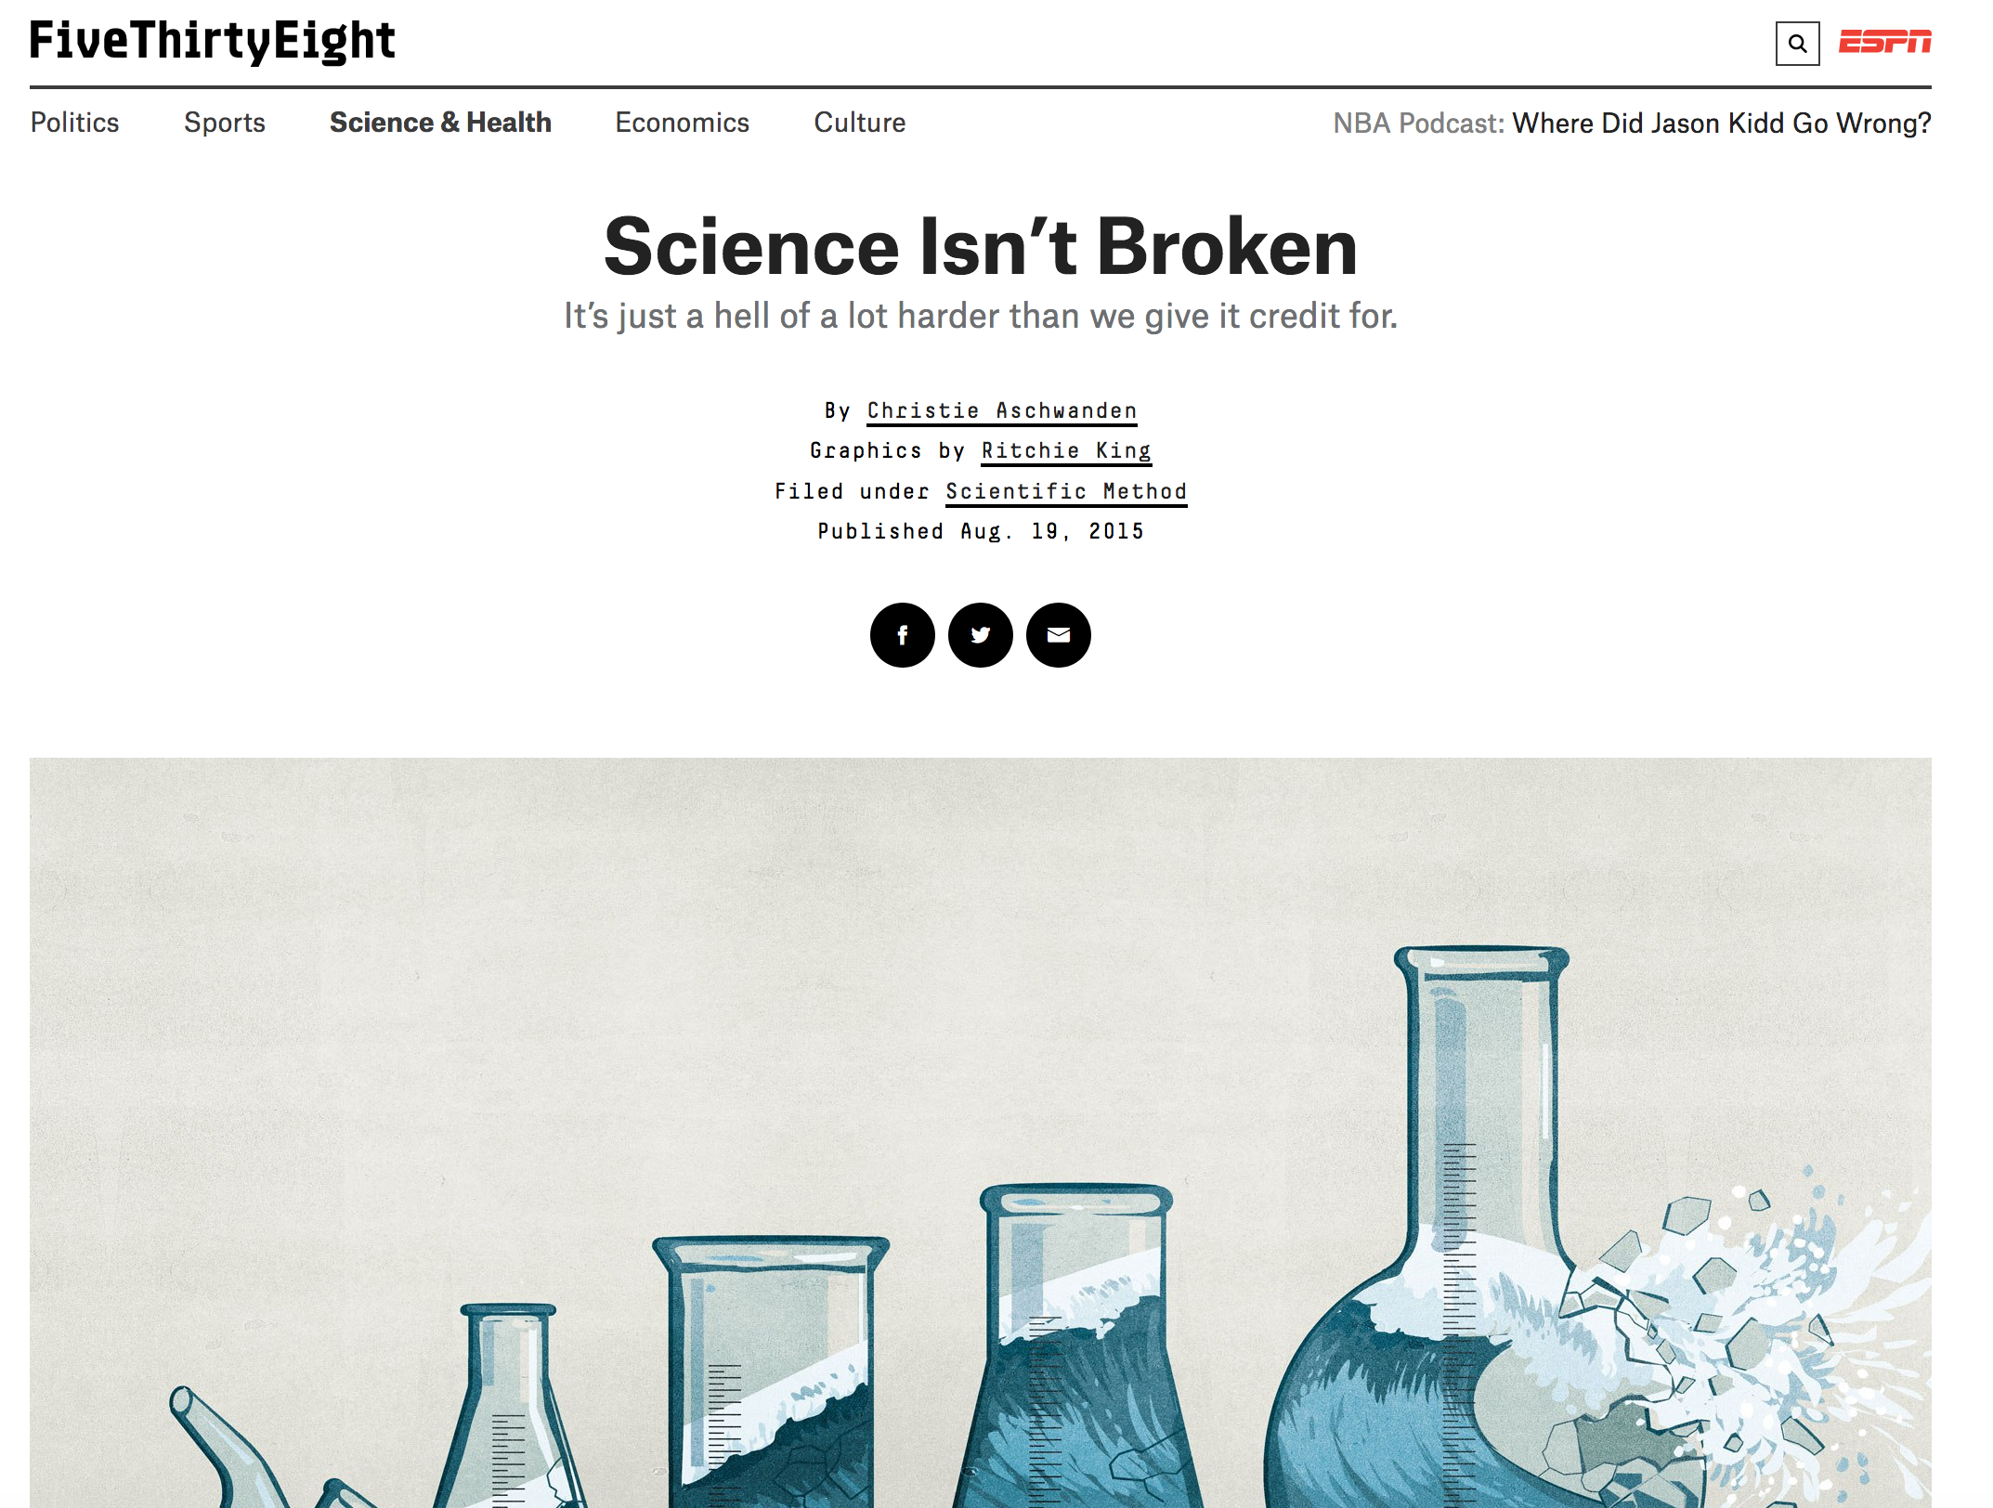
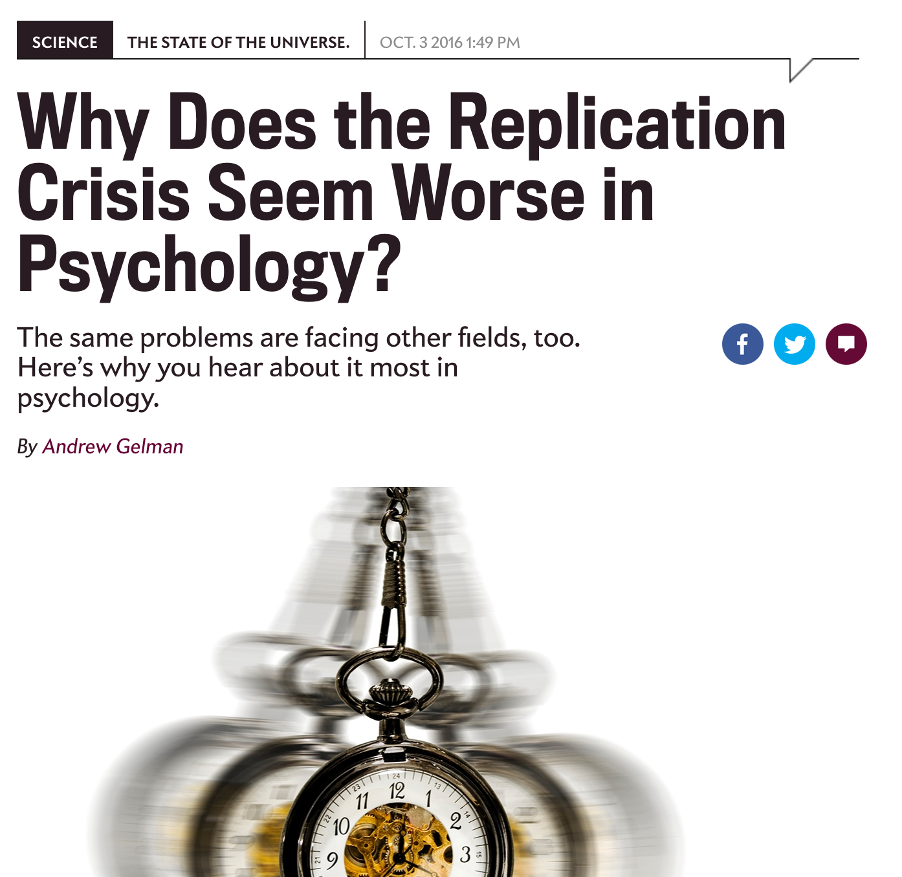
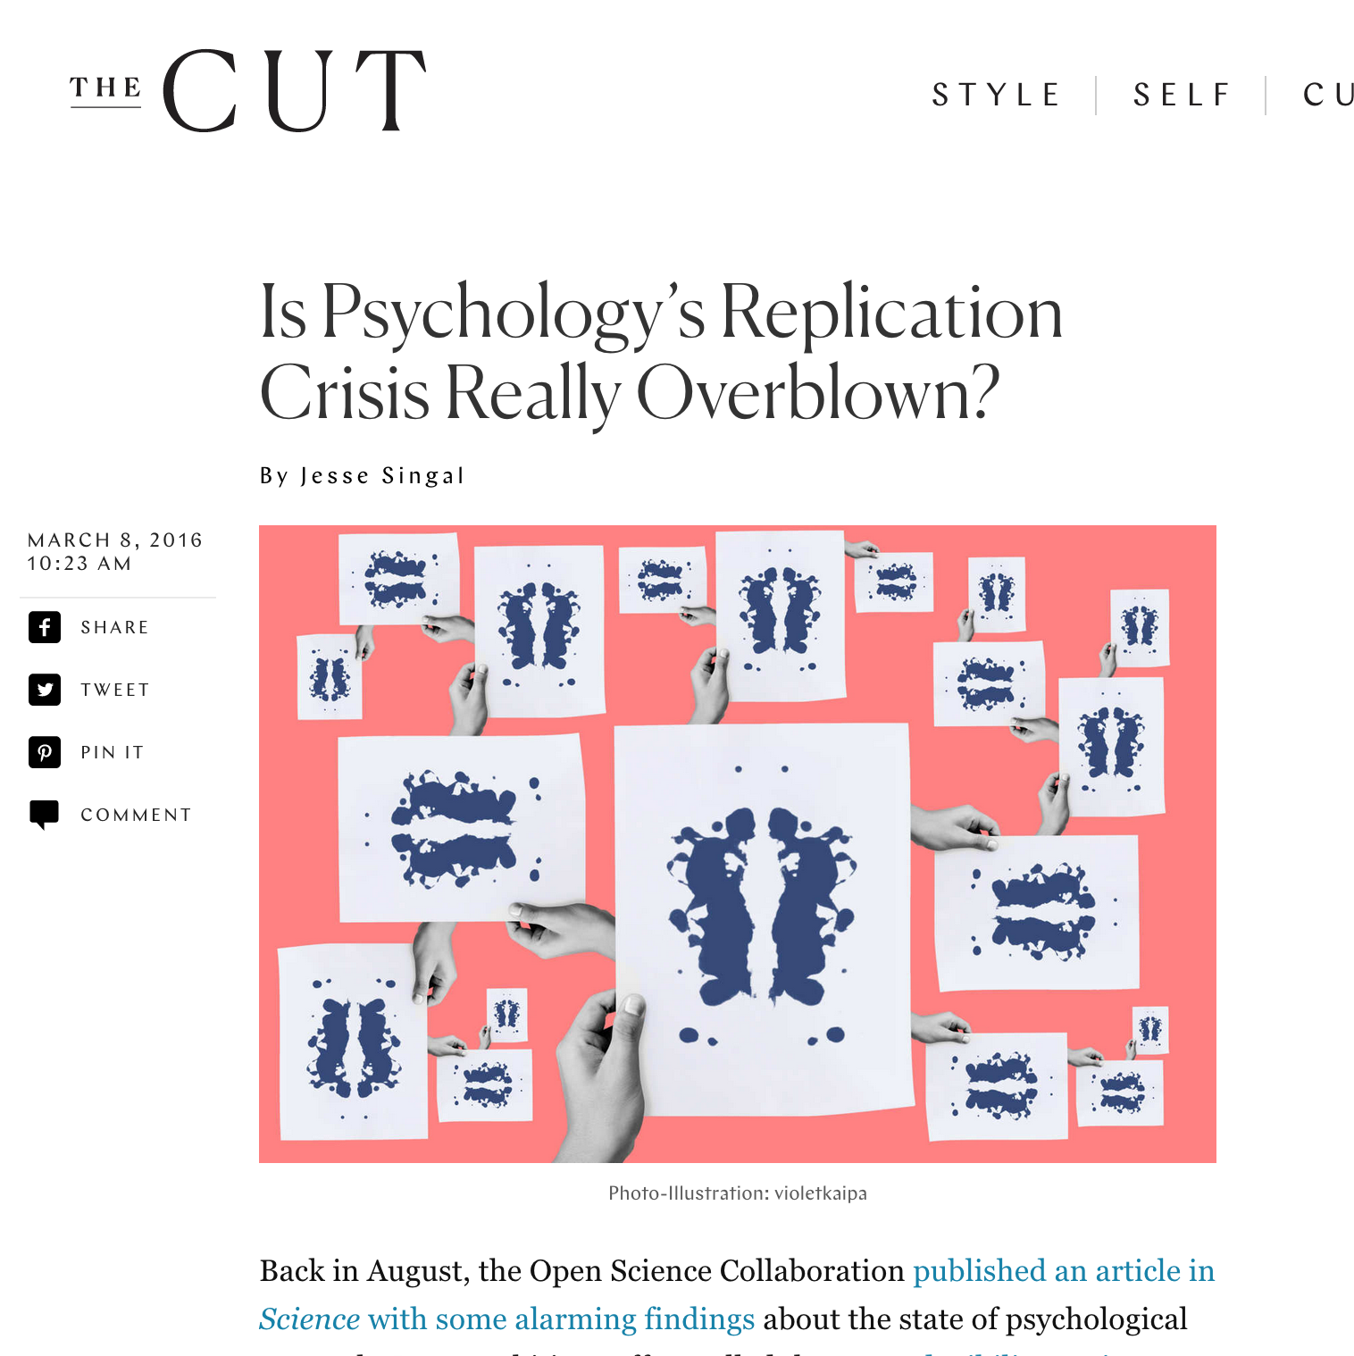
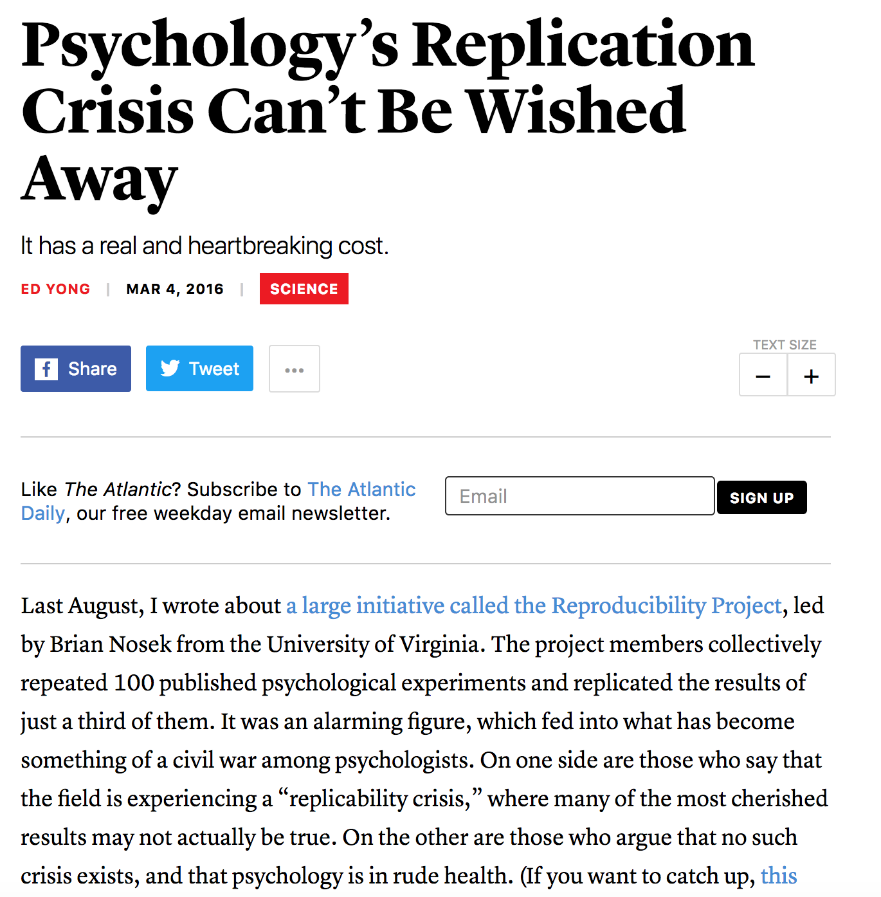
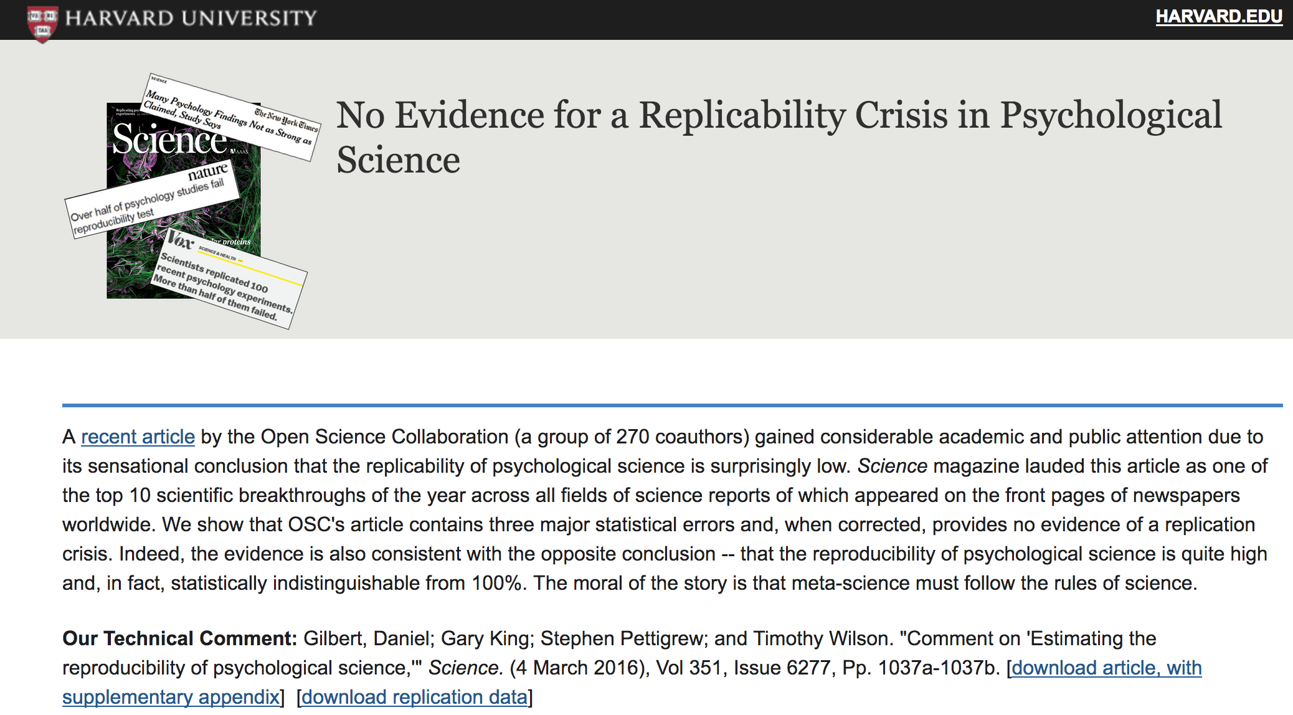
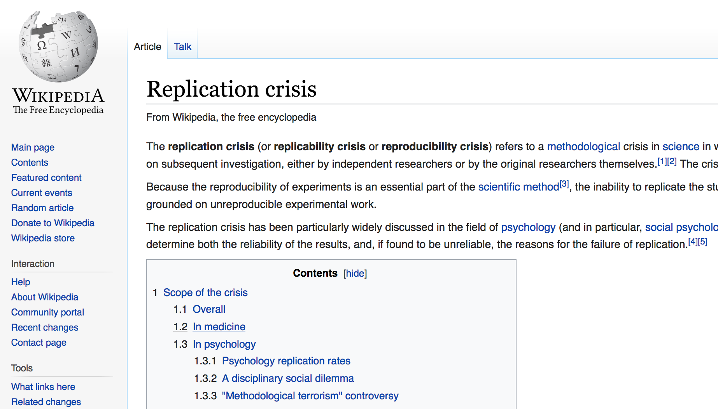
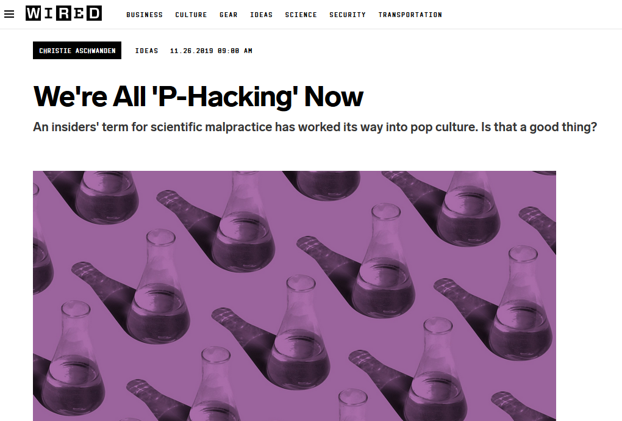
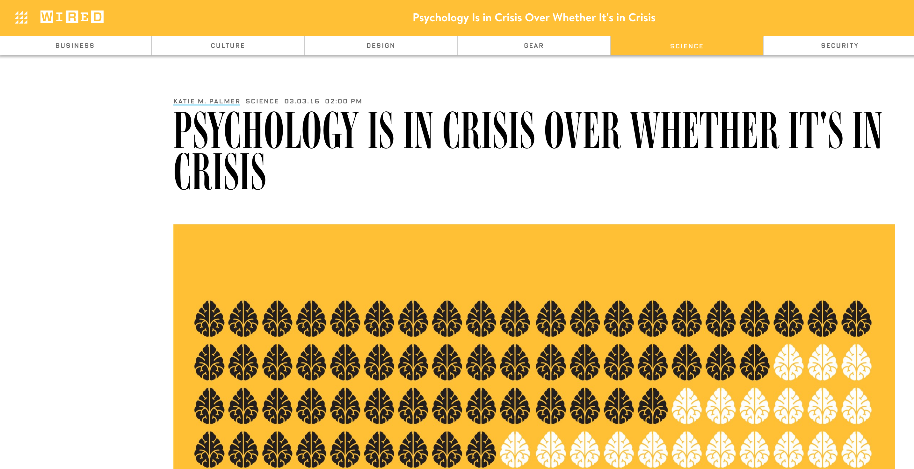
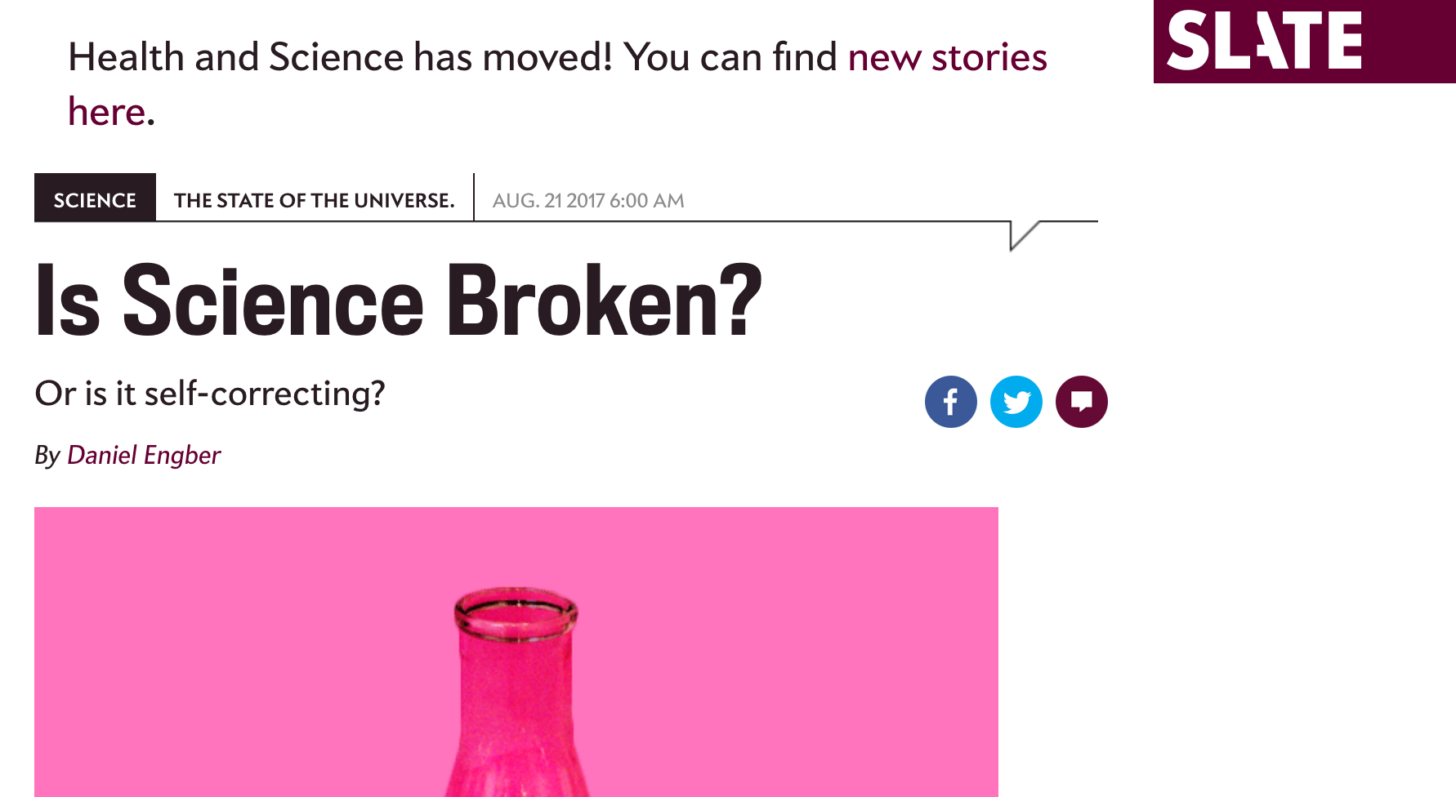

Slide 14
Episode of an NPR podcast about social science on one of various replication attempts:
http://www.npr.org/sections/money/2016/01/15/463237871/episode-677-the-experiment-experiment

Slide 15
Let’s assess whether the studies I presented a moment ago are likely to be victims of the replication crisis
How many of the studies I mentioned earlier (HPP vaccine, mumps/etc. vaccine, red wine, praying, vitamin D) used large, representative samples?
You don’t really know. I made clear that one was a single case, another had a small N, but I didn’t say about the others.
When you hear about a study that you care about, ask about the sample.

Slide 16
Sample Size and Representativeness
Many claims are based on single cases or small, non-representative samples.
Chance plays a huge role in life. Completely weird, atypical, unlikely things happen a lot.

Slide 17
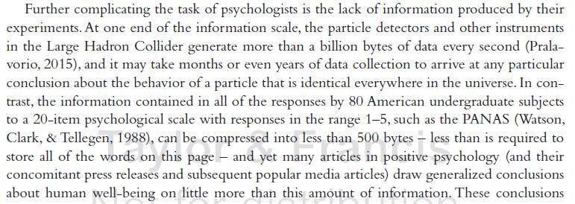
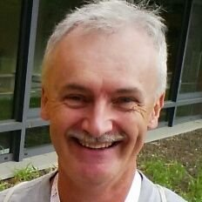
Observation from Dr. Nick Brown

Slide 18
How many of the studies I mentioned earlier (HPP vaccine, mumps/etc. vaccine, red wine, praying, vitamin D) were published in peer-reviewed (aka refereed) journal articles?
Again, you don’t really know. As is often the case in the popular media, I didn’t cite the original sources.

Slide 19
How many of the relationships had been found in more than one study?
Still don’t know. Several of those are just one-off studies.
Notes:
Come away with this realization: More often than not none of these important bits of information are published in pop articles, even though you can usually pull out our big 4 of Goals Method Results and Conclusions

Slide 20
Replications
Put more stock in studies that have been replicated (i.e., the same or similar procedures obtain the same relationships).
Ideally replicated by independent researchers.

Slide 21
Refereed Journals
Put more stock in studies reported in refereed journals.
Researchers submit a manuscript reporting their research to the Editor of a journal.
Editor sends it to two to four independent experts.
Typically the experts either reject the paper or request improvements.
The article is published only if the Editor, advised by the reviewers, judges that it meets criteria for publication.
Warning: Even good journals sometimes publish weak science, and the journal’s h-factor is not indicative of what some claim.

Slide 22
h-factors
New data suggest that past performance in science is not predictive of future performance
Why?
Perhaps most people only make one major discovery in a lifetime
Careers do not follow pre-designated trajectories
https://www.nature.com/articles/d41586-018-06627-3

Slide 23
Watching for all these will enable you to better detect (or detect absence of) surprisingly typical Questionable Research Practices as a reader or safeguard against them as a researcher
Selective reporting of DVs
Exercising optional stopping
Running many studies, finding nothing, then running one more and finding something and only reporting the last one
HARKing, or adding IVs later
Interpreting against the data to support your theories
And of course…

Slide 24
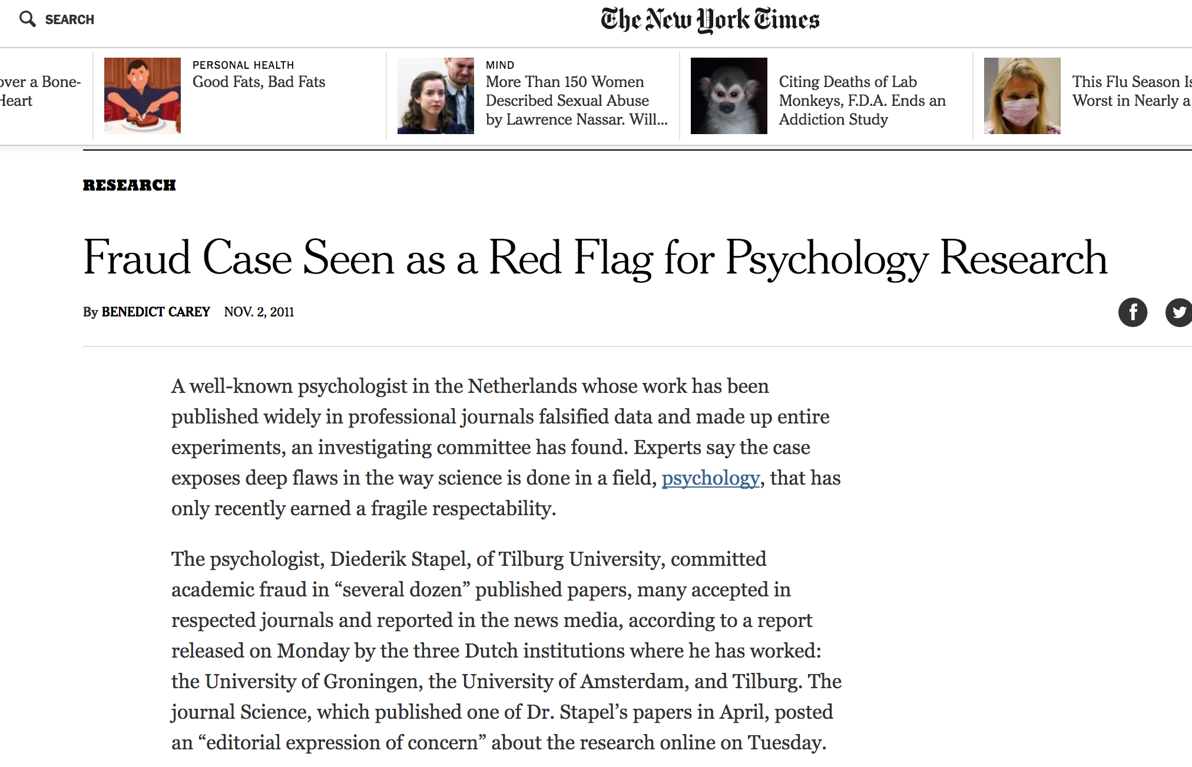

Slide 25

Conclusion
Good science is a strong way to test hypotheses.
Bad science is not.
A lot of psychology has used mediocre science.
When you hear of a surprising finding obtained in a single study, be skeptical.
Develop and use skills to tell shit from Shinola when it matters.

Slide 26
Parting resources
An example of good(?) science journalism? https://twitter.com/KABBFOX29/status/1044575221267738624
An example of another good(!) lecture on this topic: https://www.youtube.com/watch?v=NxO6E64ymYU
More thoughts on the rep. crisis entitled “Why Bad Science Spreads”: https://www.youtube.com/watch?v=fq8HOguXGFI

