Slide 1

PSYCH 3304 – Psychology of Learning
M/W/F 11:00-11:50 am
January to May 2020 in STEM 269
ONLINE AFTER COVID-19
Instructor: Dr. Mario Baldassari mbaldassari@tamusa.edu, @MarioBaldassari
Office hours Tues 2-3pm & 5-6pm, Fri 9-11am in STEM 237E (or by appt)
Please make an appointment ahead of time if you plan to visit office hours.

Slide 2
Date | Topic (reading) | Due | Also Due
23-Mar | Discrimination & Peak Shift (Ch 8) | Dunsmoor presentation/summary
30-Mar | Extinction (Ch 9) | Ch 8 Quiz | Van den Akker & Engelhard presentations/summaries
6-Apr | No new topic, do the exam this week. | Ch 9 Quiz | Perdue & Hanus summaries
13-Apr | Comparative Cognition (Ch 11 & 12) | Exam 2
20-Apr | Observation & Motor Skills | Ch 11/12 Quiz | Hebranson & Tennie presentations/summaries
27-Apr | Conclusion & Review | Quiz | McGuigan & Thompson presentations/summaries
11-May | Final exam date | Final exam | Final paper due 11:59pm

Slide 3
LOs
Define and cite examples of social and asocial learning
Differentiate theories/formulas between social and asocial learning
Cite examples of over-imitation
Describe features of Bandura’s social-cognitive theory

Slide 4
Observational learning
Definition used to be: Learning from the experiences of a model.
More recent, broader: Learning by observing events and their consequences.
Allows two types of observational learning: social and asocial
Notes:
Traditionally, observational learning is defined as learning from the experiences of a model. Recent research suggests that we should adopt a broader definition:
Observational learning means learning by observing events and their consequences.
Allows two types of observational learning: social and asocial

Slide 5
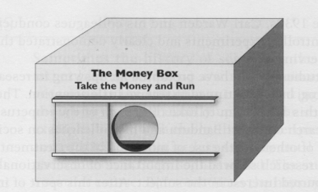

What is the social version of observational learning?
An observer (0) views a model’s behavior (M_{B}) and its positive and/or negative consequences (S^{+/-}).
  If the consequences of the model’s behavior strengthen the observer’s tendency to behave in a similar way, behavior has been vicariously reinforced.
  If weaken, then vicariously punished.
  Usually model = observer
A hypothetical example: You see a woman sitting at a table with a box on it that reads, “The Money Box. Take the Money and Run.”
Notes:
The social version of observational learning typically involves observing the behavior of another individual (usually of the same species as the observer) and the consequences of the model’s behavior. The experience may be represented thus: O[MB -> S+-]
An observer (0) views a model’s behavior (M_{B}) and its positive and/or negative consequences (S^{+/-}).
If the consequences of the model’s behavior strengthen the observer’s tendency to behave in a similar way, we say the behavior has been vicariously reinforced.
If weaken, then vicariously punished.
Usually the consequences that reinforce or punish the model’s behavior have a similar effect on the observer’s behavior.
A hypothetical example may help: Money Box
You see a woman seated in front of a table with a large box on it (Figure 10-1). The box has a sign that reads, “The Money Box. Take the Money and Run.” Slide left; Bunch of $20s; Woman takes one, smiles. Leaves. Now you. What do you do? (Think about this for a moment before reading on.)

Slide 6
Social observational learning
Equivalent study run with chimps and grapes. Observer watch 58 times vs. Non-observer. All observers solved and most slid in same direction. Less than half of controls solved.
3-5 yo children with stickers. 15 obs; All observers slid door in same direction; easy for controls to solve, though.
Notes:
Equivalent study run with chimps and grapes. Observer watch 58 times vs. Non-observer. All observers solved and most slid in same direction. Less than half of controls solved.
3-5 yo children with stickers. 15 obs; All observers slid door in same direction; easy for controls to solve, though.

Slide 7
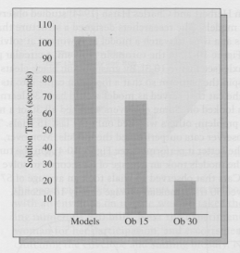
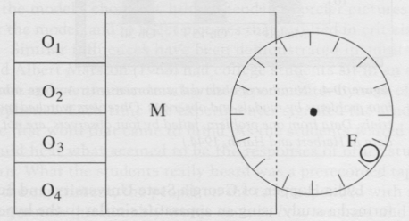
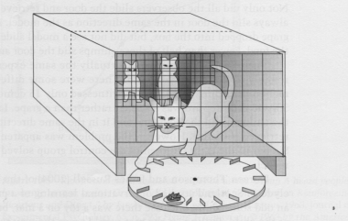
What are some key methods for studying social obs learning?
Many studies of the social version of observational learning involve problem solving.
Herbert and Harsh (1944) studied cats
Designed a structure that allowed 4 cats to watch a model as it worked at solving one of five problems, such as the turntable problem.
Notes:
As in these experiments, many studies of the social version of observational learning involve problem solving. Herbert and Harsh (1944) studied observational learning in cats using models.
The researchers designed a structure that allowed as many as four cats at a time to watch a model as it worked at solving one of five problems, such as the turntable problem.
Model would have 30 learning trials while observer cats looked on. Some observers watched all 30 of a model’s trials before tackling a problem; others watched only the last 15 trials.
Results showed that the observer cats outperformed the models. Moreover, the more observing a cat did, the better it performed—models took an average of 115 seconds to solve the problem on the first trial. Cats that observed 15 trials took an average of 57 seconds, and those that observed 30 trials took an average of only 16 seconds.

Slide 8
Methods for studying social obs learning
Not all studies involve problem solving
Levy et al. (1974): model reinforcement and punishment on the picture preferences of children
Children ranging from preschoolers to sixth graders looked on as a model went through a series of picture pairs, indicating preferences
Each choice resulted in approval, disapproval, or a neutral consequence from an adult.
The observers then did same
Children were influenced by the consequences of the model’s choices.
Notes:
Not all studies of observational learning involve learning to solve a problem or perform a skill. Levy et al. (1974), for example, studied the effects of model reinforcement and punishment on the picture preferences of children.
In one experiment, children ranging from preschoolers to sixth graders looked on as a model went through a series of picture pairs, indicating which of each pair she preferred.
Each of these choices resulted in approval, disapproval, or a neutral consequence from an adult. The observers then went through the picture pairs and indicated their own preferences.
The results showed that the children were influenced by the consequences of the model’s choices. Children tended to prefer pictures that won approval for the model, and to reject pictures that resulted in criticism of the model.

Slide 9

Asocial obs learning
The asocial version of observational learning consists of learning from observed events in the absence of a model.
Model replaced by Event, thus no
vicarious reinf or punish
Hopper et al., 2008: Chimps had a
“ghost condition” - no model to observe;
pulled open by invisible fishing line.
All eight chimps in the ghost condition solved
the problem, 3/8 control chimps did
Notes:
The asocial version of observational learning consists of learning from observed events in the absence of a model. It is not news to anyone that people learn from their surroundings in the absence of models, but this form of learning hasn’t been thought of as observational. The experience involved may be represented thus (reveal equation)
This is read: An observer (0) views an event {E) and its positive and/or negative consequences (S^{+/-}). Note that since there is no model, there can be no vicarious reinforcement or punishment, yet the observer’s behavior is influenced by the consequences of an event.
. Consider a variation on the money box. Empty room with table/chair. Two men enter with money box. One of the men is considerably taller than the other, and as they carry the box, the panel slides to the left, toward the shorter man, revealing a hole in the box. See thick envelope. As the men set the box down on the table the panel slides to the right, covering the hole.
Next, one of the experimenters escorts you to the room and signals that you should sit at the table, facing the box. He says, “You have one minute to solve the problem,” then leaves the room. What do you do?
You may not “take the money and run,” but it’s likely that you will slide the door to the left and retrieve the envelope even though you saw no model do this. As this example suggests, we are capable of learning a great deal from observing events in the absence of models.

Slide 10
Social v. Asocial?
Michael Tomasello (1998) : “If a mother chimpanzee rolls a log and eats the insects underneath, her child will very likely follow suit. . . but the youngster would have learned the same thing if the wind, rather than the mother, had caused the log to roll over and expose the ants.”
Perhaps too far, but an important question
A main difference between social and asocial observational learning involves imitation.
Notes:
So if observational learning can happen without another person, to what extent is social learning truly social? Could I it just be represented like asocial learning, in that we learn from the event? Or does the presence of the Model change something significant? (Heyes, 2012).
Michael Tomasello (1998) writes,
“If a mother chimpanzee rolls a log and eats the insects underneath, her child will very likely follow suit. . . but the youngster would have learned the same thing if the wind, rather than the mother, had caused the log to roll over and expose the ants
The research suggests that this statement goes too far, that there are differences in what is learned in the presence and absence of a model.
Yet we do have to wonder how much of the learning that occurs in observing a model is due to the action of the model, and how much is due to observing the physical events that occur.
A main difference between social and asocial observational learning involves imitation.

Slide 11
Imitation
Traditionally, to imitate is to behave in a way that resembles the behavior of a model.
More broadly, “to perform an observed act, whether modeled or not.”
People tend to imitate observed behavior even when it is clearly irrelevant to producing reinforcement.
Notes:
. Traditionally, to imitate is to behave in a way that resembles the behavior of a model. More broadly, to imitate” could be defined as “to perform an observed act, whether modeled or not.” However, most research on imitation involves models, so we will focus on imitation as the performance of modeled behavior.
People tend to imitate observed behavior even when it is clearly irrelevant to producing reinforcement. In fact, humans seem to be downright compulsive about imitating the details of modeled behavior.

Slide 12
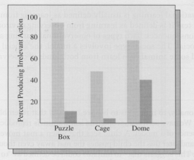
Imitation
Lyons, Young, & Keil (2007): 3- to 5-year-old children identified actions that were irrelevant to the solution of problems.
When answered correctly, heaped praise; if incorrect, feedback.
After training, new kind of container and demo with irrelevant steps. Would child would imitate those steps? (exptr left room)
Over-imitation – despite all efforts to get the children to do only what was necessary
Notes:
Lyons, Young, & Keil (2007) trained 3- to 5-year-old children to identify actions that were irrelevant to the solution of problems.
E.g., Jar with a toy dinosaur inside, tapped the jar with a feather, unscrewed the lid, and removed the toy. Then they asked the child which acts had been necessary to get the dinosaur and which were silly.
When answered correctly, heaped praise; if incorrect, feedback.
After training, new kind of container with a toy turtle inside and demonstrated how to get the turtle. The demonstration included irrelevant steps. The question was whether the child would imitate those steps.
Since the child might feel some pressure to imitate the adult’s irrelevant acts if he were present, the experimenter said he had to leave the room, but before leaving suggested that the child remove the turtle “however you want.”
Despite these efforts to discourage imitation of irrelevant acts, the children imitated them. Children who took on.the task of removing the turtle without watching a model do it were successful and seldom engaged in unnecessary actions (see Figure 10-8).
Over-imitation – despite all efforts to get the children to do only what was necessary

Slide 13
Over-imitation: Adults too
Tennie, Call, and Tomasello (2006): Model push/pull swinging door
The proportion of children who matched the model increased steadily with age from 12 to 24 months.
Nicola McGuigan et al. (2007) and McGuigan & Graham (2010) found 5-year-old children more likely to over-imitate than 3-year-olds
McGuigan (2012) suggests that over-imitation progresses steadily into adulthood.
Notes:
It’s tempting to dismiss over-imitation as the result of immaturity, but in fact it seems that in humans the tendency to over-imitate increases with age. Tennie, Call, and Tomasello (2006) had children look on as a model obtained a toy in a box by opening a swinging door. The door could be opened by pushing or pulling. Some children saw a model open the door by pushing it, others saw a model pull the door open.
The proportion of children who matched the model increased steadily with age from 12 to 24 months. Nicola McGuigan and colleagues (2007, McGuigan & Graham, 2010) found that 5-year-old children were more likely to over-imitate than 3-year-olds. McGuigan (2012) suggests that over-imitation progresses steadily into adulthood.

Slide 14
So how does it work?
The two main theories of observational learning are the social cognitive theory of Albert Bandura and the operant learning model.
Both theories focus on the social form of observational learning, though the operant model applies as well to both forms of observational learning.
Notes:
The two main theories of observational learning are the social cognitive theory of Albert Bandura and the operant learning model. Both theories focus on the social form of observational learning, though the operant model applies as well to both forms of observational learning.

Slide 15
https://youtu.be/dmBqwWlJg8U

Slide 16
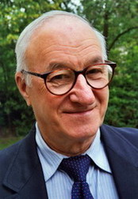
Bandura’s social-cognitive theory
4 kinds of cognitive processes: attentional, retentional, motor-reproductive, and motivational.
Attentional processes: the individual directing their attention to the relevant aspects of the model’s behavior and its consequences.
  “…involves self-directed exploration of the environment and construction of meaningful perception from ongoing modeled events”
Retentional processes: representing the model’s behavior to aid recall
  “After modeling stimuli have been coded with images or words for memory representation they function as mediators for response retrieval and reproduction”
  Can include covert rehearsal
Notes:
Albert Bandura developed a theory that focuses on cognitive processes. He does not deny that environmental and biological events influence behavior, but in his view it is cognitive processes—things going on inside the person—that account for learning from models.
His theory identifies four kinds of cognitive processes: attentional, retentional, motor-reproductive, and motivational.
Attentional processes have to do with the individual directing their attention to the relevant aspects of the model’s behavior and its consequences.
“involves self-directed exploration of the environment and construction of meaningful perception from ongoing modeled events”
The term self-directed is critical because it suggests that what determines where we look and what we listen to originates inside us.
The word construction likewise indicates that what we derive from the things we observe is less the product of those things than of something going on inside of us.
Retentional processes involve representing the model’s behavior in some way, typically in words or images, to aid recall.
“After modeling stimuli have been coded with images or words for memory representation they function as mediators for response retrieval and reproduction”
He gives the example of observing a model who follows a certain route to get to a particular location.
The model’s movements can be “encoded” in images (scenes of objects passed along the way) or as a sequence of right and left turns such as RRLRLL.
Retentional processes also include covert rehearsal, such as silently saying the RRLRLL sequence repeatedly.

Slide 17
Bandura’s social-cognitive theory
Motor-reproductive processes: using the symbolic
representations from retentional processes to guide action.
  “It is assumed that reinstatement of representational schemes provides a basis for self-instruction on how component responses must be combined and sequenced to produce new patterns of behavior”
Motivational processes: evaluating the consequences of imitating
  “When favorable incentives are introduced,” Bandura writes, “observational learning promptly emerges in action”
  Consequences affect expectations

Slide 18
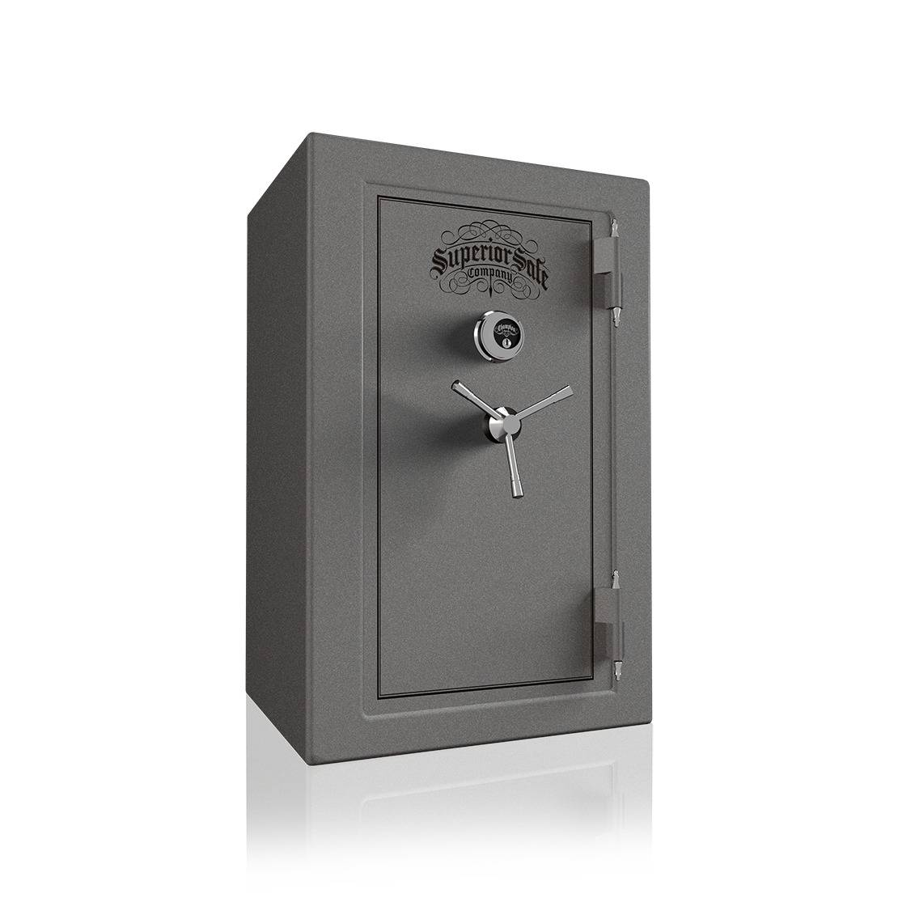
Bandura’s social-cognitive theory
These are hypothetical cognitive
processes, but we can illustrate.
Notes:
These hypothetical cognitive processes can be illustrated at ‘east in part. (Some of the processes presumably take place unconsciously and so cannot be described.) Suppose your aunt points to a wall safe and says, “I’m going to open that safe and then lock it again. If you can open it, you can keep whatever you find inside.”
Your aunt then proceeds to open the safe. She turns the dial clockwise to 20, counterclockwise to 40, clockwise to 20. She pulls down the handle and swings open the door, then immediately closes it.
Now, as you watch your aunt work, you direct your attention to which way she turns the safe dial and the numbers at which she stops. You may also represent her behavior by picturing a little pot-bellied Santa Claus whose measurements are 20—40—20. More likely, however, you repeat to yourself (or perhaps aloud), “Right 20; left 40; right 20.” After Auntie has demonstrated how to open the safe, you covertly practice the motor skills necessary for opening it, using the Santa Claus image or the code, “Right 20, left ’40’, right 20,” to guide you. But whether you imitate your aunt’s behavior will depend, according to Bandura, on whether you expect to receive something of value after opening the safe.

Slide 19
Bandura’s social-cognitive theory
If a hypothetical process can’t be measured… what’s it really doing?
What does it mean to say that attention is self-directed?
Motivation is important, but does the expectation of reward explain why people imitate a model?
Because of such problems, some researchers prefer explanations that view observational learning as a form of operant learning.
Notes:
Bandura’s theory has tremendous intuitive appeal. The theory is not, however, without its problems.
We might question, for example, the explanatory value of unobservable and unmeasurable hypothetical processes.
What does it mean, for example, to say that attention is self-directed?
Similarly, motivation is important, but does the expectation of reward explain why people imitate a model? If you know that your aunt is rich and that rich people often keep valuable things in safes, then you might very well expect that opening the safe will be reinforced. But is it the expectation of reward that explains your behavior or the learning experiences that led to that expectation?
Because of such problems, some researchers prefer explanations that view observational learning as a form of operant learning.

Slide 20
The operant learning model
Discriminative stimuli play a crucial role in operant conditioning both inside and outside the laboratory. E.g. light color
In observational learning. discriminative stimulus is the behavior of another person
Miller & Dollard: First-grade children participated in this experiment in pairs, with one child being the “leader” and the other the ‘learner.” On each of several trials, the two children would enter a room in which there were two chairs with a large box on top of each.
The leader was instructed in advance to go to one of the two boxes, where there might be a piece of candy. The learner could see where the leader went, but not whether the leader obtained any candy.
  Next, it was the learner’s turn
  Half reinforced for making the same choice as the leader.
  Others reinforced if their choice was opposite that of the leader.
After a few trials, children in the imitation group always copied the response of the leader, and those in the non-imitation group always made the opposite response.
Notes:
Opearant Learning Model. It is possible to treat observational learning as a variation of operant learning. We have already seen that discriminative stimuli play a crucial role in operant conditioning both inside and outside the laboratory.
For instance, a laboratory animal may learn to make one response in the presence of a red light, another response in the presence of a green light, and yet another response in the presence of a yellow light.
Observational learning involves situations where the discriminative stimulus is the behavior of another person, and the appropriate response just happens to be a similar behavior on the part of the observer.
Consider an experiment by Miller & Dollard. First-grade children participated in this experiment in pairs, with one child being the “leader” and the other the ‘learner.” On each of several trials, the two children would enter a room in which there were two chairs with a large box on top of each.
The leader was instructed in advance to go to one of the two boxes, where there might be a piece of candy. The learner could see where the leader went, but not whether the leader obtained any candy.
Next, it was the learner’s turn to go to one of the two boxes, where he or she might or might not find a piece of candy. Half of the learners were in an imitation group—they were reinforced for making the same choice as the leader. The other learners were in the non-imitation group—they obtained reinforcement if their choice was opposite that of the leader.
The result of this simple experiment was not surprising: After a few trials, children in the imitation group always copied the response of the leader, and those in the non-imitation group always made the opposite response.
Miller and Dollard concluded that, like any other operant response, imitation will occur if an individual is reinforced for imitating. Conversely, non- imitation will occur if non-imitation is reinforced. In both cases, the behavior of some other person is the discriminative stimulus that indicates what response is appropriate.

Slide 21
Mirror neurons
Mirror neurons fire both when an animal makes a certain movement and when the animal observes someone else make that movement.
First study found neurons that would fire when a monkey reached for a piece food, but also when the experimenter reached for the food (Di Peliegrino, Fadiga, Gallese, & Rizzolatti, 1992).
The discovery of mirror neurons renews debate on whether obs and operant learning differ
Humans too, neurons become active both when the person makes a movement and when the person observes someone else make the same movement (Rizzolatti, Craighero, & Fadiga, 2002).
Notes:
Mirror Neurons.
What makes mirror neurons unique is that they fire both when an animal makes a certain movement and when the animal observes someone else make that movement.
They were discovered by accident while researchers were recording from individual neurons in a monkey’s premotor cortex, an area of the brain involved in hand movement and grasping.
They found neurons that would fire when a monkey reached for a piece food, but also when the experimenter reached for the food (Di Peliegrino, Fadiga, Gallese, & Rizzolatti, 1992).
The discovery of mirror neurons in macaque monkeys in the early 1990s and their subsequent discovery in humans have added a new dimension to the discussion about whether observational learning is a unique and special type of learning, different from operant learning.
Studies using brain-imaging techniques then identified areas of the human brain that act in a similar way—they become active both when the person makes a movement and when the person observes someone else make the same movement (Rizzolatti, Craighero, & Fadiga, 2002).
More recently, individual motor neurons were found in human patients during the course of brain surgery (Keysers & Gazzola, 2010).

Slide 22
Mirror neurons
Mirror neurons have received a great deal of attention, might tell us more than just obs learning
They may be important for normal social interactions and communication (Oberman & Ramachandran, 2009).
Possibly part of ASD (Bernier & Dawson, 2009), but popularity of this hypothesis is overblown
If mirror neurons aid obs learning, species of animals that are most capable of observational learning should be those that have well-developed mirror neuron systems… future work?
One study with sparrows found neurons in their brains that responded both when the birds sang a specific song and when they heard it (Prather, Peters, Nowicki, & Mooney, 2008).
Notes:
Mirror neurons have received a great deal of attention because brain researchers have speculated that they could be involved in a number of important human capabilities. Because mirror neurons respond both when we act and when we see others act, they may help us to understand the actions, intentions, and feelings of other people.
Therefore, they may be important for normal social interactions and communication (Oberman & Ramachandran, 2009).
Research on children and adults with autism spectrum disorders has found evidence that their mirror neurons may not function in the same ways as those of normal individuals (Bernier & Dawson, 2009).
The evidence is preliminary and incomplete, but if it corroborated it could help to explain why people with autism often have difficulties in communication and in understanding the intentions of others.
Not surprisingly, it has also been suggested that mirror neurons are important for observational learning and imitation—they may help to make the connection between seeing someone else perform some action and then being able to perform it ourselves.
If so, then the species of animals that are most capable of observational learning should be those that have well-developed mirror neuron systems. It will be interesting to see if future research with other species supports this hypothesis.
So far, almost all the research on motor neurons has been conducted with humans and other primates.
However, one study with sparrows found neurons in their brains that responded both when the birds sang a specific song and when they heard it (Prather, Peters, Nowicki, & Mooney, 2008).

