Slide 1

PSYCH 3304 – Psychology of Learning
M/W/F 11:00-11:50 am
January to May 2020 in STEM 269
ONLINE AFTER COVID-19
Instructor: Dr. Mario Baldassari mbaldassari@tamusa.edu, @MarioBaldassari
Office hours Tues 2-3pm & 5-6pm, Fri 9-11am in STEM 237E (or by appt)
Please make an appointment ahead of time if you plan to visit office hours.
Notes:
SCIENCE

Slide 2
Date | Topic (reading) | Due | Also Due
23-Mar | Discrimination & Peak Shift (Ch 8) | Dunsmoor presentation/summary
30-Mar | Extinction (Ch 9) | Ch 8 Quiz | Van den Akker & Engelhard presentations/summaries
6-Apr | No new topic, do the exam this week. | Ch 9 Quiz | Perdue & Hanus summaries
13-Apr | Comparative Cognition (Ch 11 & 12) | Exam 2
20-Apr | Observation & Motor Skills | Ch 11/12 Quiz | Hebranson & Tennie presentations/summaries
27-Apr | Conclusion & Review | Quiz | McGuigan & Thompson presentations/summaries
11-May | Final exam date | Final exam | Final paper due 11:59pm

Slide 3
Learning outcomes
After this hour, you will be able to…
Predict the presence of excitatory and inhibitory stimulus generalization gradients
Describe the peak shift phenomenon and posit a theory as to why it happens

Slide 4
What is stimulus generalization?
Guttman & Kalsih (1956)
Widely different objects or events can be considered the same stimulus if share the same function
  A wheel, despite material, always a wheel
Other stim distinguished in terms of precise physical features
  Small variations in wavelength change radio station
Notes:
. Stimulus Generalization. Identifying and differentiating various stimuli is not a simple matter. Stimuli may be defined in all kinds of ways. Sometimes widely different objects or events are considered instances of the same stimulus because they all share the same function.
A wheel, for example, may be small or large, spoked or not spoked, and made of wood, rubber or metal—but it is still a wheel
By contrast, stimuli in other cases are identified and distinguished in terms of precise physical features such as wavelength of light or the frequency of radio waves
E.g., listen to a particular FM station and you have to tune your radio within a very small range on the FM band—small variations will significantly change the quality of the reception

Slide 5
Stimulus generalization
Stevens, 1951: The problem is central to our analysis of stimulus control
Show stim generalization if organism responds in a similar fashion to 2 or more stimuli
Pavlov: After one stimulus used as a CS, his dogs would also make conditioned response to other similar stimuli
In IC, Guttman & Kalish (1956) first, reinforced pigeons on VI schedule for pecking illuminate yellowish-orange light with a wavelength of 580nm
After training, the birds were tested with a variety of other colors presented in a random order without reinforcement and the rate of responding for each color was recorded
Notes:
Psychologist and physiologists have long been concerned with how organisms identify and distinguish different stimuli. Some have suggested that this is the single most important question in psychology (Stevens, 1951)
The problem is central to our analysis of stimulus control
In addition to stimulus discrimination and differential responding, we must also be aware of stimulus generalization, which is essentially the opposite of the first two
Show stim generalization if organism responds in a similar fashion to 2 or more stimuli
Stim gen first observed by Pavlov
After one stimulus used as a CS, his dogs would also make conditioned response to other similar stimuli
That is, they failed to respond differentially to stimuli that were similar to the original conditioned stimulus
Stim gen also examined in instrumental conditioning – landmark (Guttman & Kalish, 1956)
First, reinforced pigeons on VI schedule for pecking illuminate yellowish-orange light with a wavelength of 580nm
After training, the birds were tested with a variety of other colors presented in a random order without reinforcement and the rate of responding for each color was recorded
See next slide for results

Slide 6
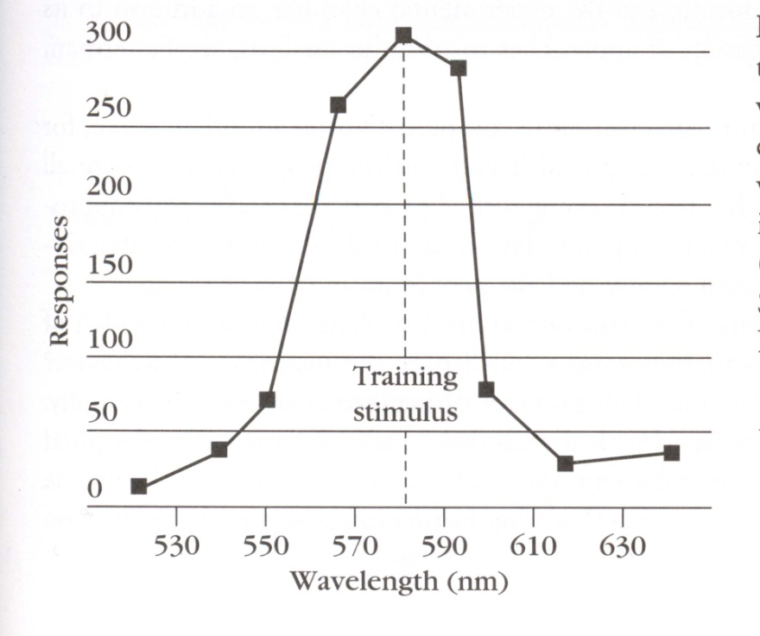
Stimulus generalization
Highest rate of pecking to original 580nm color—but also made a number of pecks to 570nm and 590nm
However, as color of test stimuli became increasingly different from original color, progressively fewer responses occurred
Gradient of responding—known as stimulus generalization gradient

Slide 7
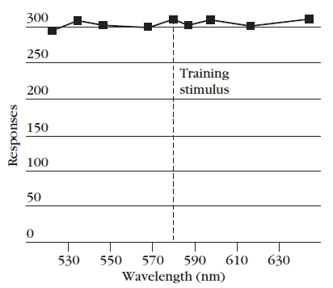
Stimulus generalization
Stimulus generalization gradients used to measure stimulus control
Information about how sensitive behavior is to variations
Determine how much a stimulus to be altered to produce change in behavior
Consider Guttman & Kalish data, Wavelength must be changed by more than 10nm
How color-blind pigeons would have responded?
See Figure for hypothetical results
If did not respond on basis of color, similar high rates of responding would have occurred
Flat gradient
Notes:
Stimulus generalization gradients are often used to measure stimulus control because they provide information about how sensitive the organism’s behavior is to variations in a particular aspect of the environment
With the use of stimulus generalization gradients, investigators can determine exactly how much a stimulus has to be altered to produce a change in behavior
Consider gradient in Table
Wavelength must be changed by more than 10nm
How do you suppose color-blind pigeons would have responded?
They couldn’t have distinguished lights on the basis of color or wavelength and therefore would have responded in much the same way regardless of what color was projected on the response key
See Figure for hypothetical results
If did not respond on basis of color, similar high rates of responding would have occurred—the gradient would have been flat

Slide 8
Stimulus generalization
Steepness of a stimulus generalization gradient provides a precise measure of the degree of stimulus control
Steep gradient shows differential responding and discrimination
Flat gradient shows no differential responding and generalization (lack of discrim)
Notes:
A comparison of the results obtained by Guttman and Kalish and the hypothetical color-blind data indicates that the steepness of a stimulus generalization gradient provides a precise measure of the degree of stimulus control
Steep gradient shows differential responding and discrimination
Flat gradient show no differential responding and generalization (lack of discrim)

Slide 9
How does stimulus generalization relate to behavior therapy?
Generalization is the key
Critically so
For treatment to be maximally useful, patient must generalize
The following, sometime contradictory, techniques have been proposed to facilitate generalization of treatment outcomes
Notes:
Stimulus generalization is critical to the success of behavior therapy. Behavior therapy, like other forms of therapy, is typically conducted under specific circumstances (in a therapists office, for example).
For the treatment to be maximally useful, what is learned during treatment should generalize outside the training situation
An autistic child, for example, who is taught certain communicative response in interaction with a particular therapist should also exhibit those response in interactions with other people
The following, sometime contradictory, techniques have been proposed to facilitate generalization of treatment outcomes

Slide 10
Stimulus generalization and therapy
Treatment situation as similar as possible to the natural environment
  Frequency of reinforcers
  The reinforcers themselves
Sequential modification: Conduct the treatment procedure in new settings
Use numerous exemplars during training
Notes:
1) First, the treatment situation should be made as similar as possible to the natural environment of the client.
For example, if the natural environment provides reinforcement only intermittently, then it is a good idea to reduce the frequency of reinforcement during treatment sessions as well.
It is also best to use the same reinforcers that the client is likely to encounter naturally.
2) Conduct the treatment procedure in new settings. This strategy is sequential modification.
After a behavior has been conditioned in one situation (a classroom), training is conducted in a new situation (a playground)
If that does not result in sufficient generalization, training can be extended to other environments
3) Use numerous exemplars during training.
In trying to extinguish fear of elevators, for example, conduct training sessions with various types of elevators

Slide 11
Stimulus generalization and therapy
Condition the new response to stimuli that are common to various situations
  Language is effective mediator
Make the training procedure indiscriminable or incidental to other activities.
  McGee, Krantz, & McClannahan (1986): took advantage of the interest autistic children showed in specific toys to teach how to read names of the toys
Generalization outside a training session is achieved if the training helps bring the individual into contact with contingencies of reinforcement available in the natural environment (natural contingencies)
  Once a response is required thru special training, the response can often be maintained by naturally available reinforcers
Notes:
4) Condition the new response to stimuli that are common to various situations
Language provides effective mediating stimuli
Response conditioned to verbal or instructional cues are likely to generalize to new situations in which those instructional stimuli are encountered
5) Make the training procedure indiscriminable or incidental to other activites.
In one study (McGee, Krantz, & McClannahan, 1986) for example, the investigators took advantage of the interest autistic children showed in specific toys during a play session to teach the children how to read the names of the toys
6) Genealization outside a training session is achieved if the training helps bring the individual into contact with contingencies of reinforcement available in the natural environment (natural contingencies)
Once a response is required thru special training, the response can often be maintained by naturally available reinforcers
E.g., reading, simple arithmetic, riding a bike—are all response that are maintained by natural reinforcers once the response have been acquired thru special training

Slide 12
What is learned in generalization?
Pavlov: learning about a CS becomes transferred to other stimuli on the basis of physical similarity
Lashley & Wade (1946) disagreed 🔥🔥🔥
  Generalization reflects the absence of learning
  Animals have to learn to treat stimuli as different
Lashley and Wade considered the shape of a stimulus generalization gradient to be determined primarily by the organism’s previous learning experiences, not physical properties
Notes:
Pavlov suggested that stimulus generalization occurs because learning about a CS becomes transferred to other stimuli on the basis of physical similarity of those test stimuli to the original CS
In a spirited attack, Lashley & Wade (1946) took exception to this proposal
They rejected the idea that generalization reflects the transfer of learning and argued that it in fact reflects the absence of learning
In particular, they proposed that stimulus generalization occurs if organisms have not learned to distinguish differences among stimuli
They proposed that animals have to learn to treat stimuli as different from one another
Thus, in contrast to Pavlov, Lashley and Wade considered the shape of a stimulus generalization gradient to be determined primarily by the organism’s previous learning experiences
Rather than by the physical properties of the stimuli used

Slide 13
What is learned in generalization?
Stimulus control can be dramatically altered by learning experiences.
Stimulus discrimination training: p’s exposed to at least two different stimuli, but reinforced for one only
In such a case, the stimulus that signals the availability of reinforcement is S+
By contrast, the stimulus that signals a lack of reinforcement is S-
Notes:
Lashley and Wade were closer to the truth than Pavlov. Numerous studies have shown that stimulus control can be dramatically altered by learning experiences.
Perhaps the most powerful procedure for bringing behavior under the control of a stimulus is stimulus discrimination training
In such a procedure, participants are expose to at least two different stimuli (e.g., red and green light) but reinforcement for a response is available only in the presence of one of the colors
E.g., only if red is on…not when green is on
In such a case, the stimulus that signals the availability of reinforcement is S+
By contrast, the stimulus that signals a lack of reinforcement is S-

Slide 14
What is learned in generalization?
Initially organisms respond similarly to S+ and S-.
Eventually decline in responding to S-
Stimulus discrimination procedures establish control by the stimuli that signal when reinforcement is available and is not available
Once S+ and S- have gained control over behavior, they are called discriminative stimuli
Notes:
Initially, in such training, organisms respond similarly in the presence of S+ and S-. As training progresses, responding in the presence of the S+ persists, and responding in the presence of S- declines.
Thus, stimulus discrimination procedures establish control by the stimuli that signal when reinforcement is available and is not available
Once S+ and S- have gained control over behavior, they are called discriminative stimuli
30 mins

Slide 15
Break

Slide 16
What is the procedure for stimulus discrimination training?
E.g., reinforce only to green light (S+) and not to red light (S-).
What is actually learned in discrimination training?
What strategies could a subject use to make sure that most of its responses were reinforced in this situation?
  1) Learn to respond whenever S+ is present and learn nothing about S-
    Respond only to S+ and get all reinforcers
  2) Learn to suppress responding during S- but not learn anything about S+
    Respond all the time, except in presence of S-…still will gain all reinforcers
  3) Learn significance of both S+ and S-; learn to respond to S+ and to suppress responding to S-
Notes:
When we left off last time, we described stimulus discrimination training procedures—which were rather straightforward—e.g., reinforce only to green light (S+) and not to red light (S-).
We ended by asking what is actually learned in discrimination training? Let’s answer that by asking it slightly differently:
What strategies could a subject use to make sure that most of its responses were reinforced in this situation?
1) Learn to respond whenever S+ is present and learn nothing about S-
Respond only to S+ and get all reinforcers
2) Learn to suppress responding during S- but not learn anything about S+
Respond all the time, except in presence of S-…still will gain all reinforcers
3) Learn significance of both S+ and S-; learn to respond to S+ and to suppress responding to S-

Slide 17

Spence’s theory of discrimination learning
Spence (1936)
Spence (1936) based on #3
Reinforcement of a response in the presences of S+ conditions excitatory response tendencies to S+
Nonreinforcement of responding during S- conditions inhibitory properties to S- that serve to suppress the instrumental behavior
Differential responding to S+ and S- reflects both the excitation of responding to S+ and the inhibition of responding to S-
Notes:
. Spence’s Theory of Discrimination Learning. One of the first and most influential theories of discrimination learning, proposed by Spence (1936), is based on the last of the possibilities described above.
According to this theory, reinforcement of a response in the presences of S+ conditions excitatory response tendencies to S+
By contrast, nonreinforcment of responding during S- conditions inhibitory properties to S- that serve to suppress the instrumental behavior
Differential responding to S+ and S- is assumed to reflect both the excitation of responding to S+ and the inhibition of responding to S-

Slide 18
Spence’s theory of discrimination learning
Could test using stimulus generalization gradients
If excitatory tendency conditioned to S+, expect steep generalization gradient
If inhibitory tendency conditioned to S-, expect inverted gradient
When Spence wrote, methods didn’t exist!
Notes:
. With any theory, we must ask: how can this theory be experimentally evaluated? The mere observation that organisms respond more to S+ than to S- is not sufficient to prove that they have learned something about both of these stimuli.
More sophisticated tests are required—one possibility is to use stimulus generalization gradients
If an excitatory tendency has become conditioned to S+, then one should expect a steep generalization gradient (most responding to S+, quick drop off in responding as difference increases)
Known as an excitatory stimulus generalization gradient
Conversely, if an inhibitory tendency has become conditioned to S-, then should show an inverted gradient
Should be very effective at inhibiting stimuli very similar to S-, but increasingly less effective as difference in stimuli increases
Draw on board – inhibitory stimulus generalization gradient
When Spence proposed his theory, these behavioral techniques were not around yet—so no test was available until decades later
Subsequent tests have shown that his ideas were substantially correct

Slide 19
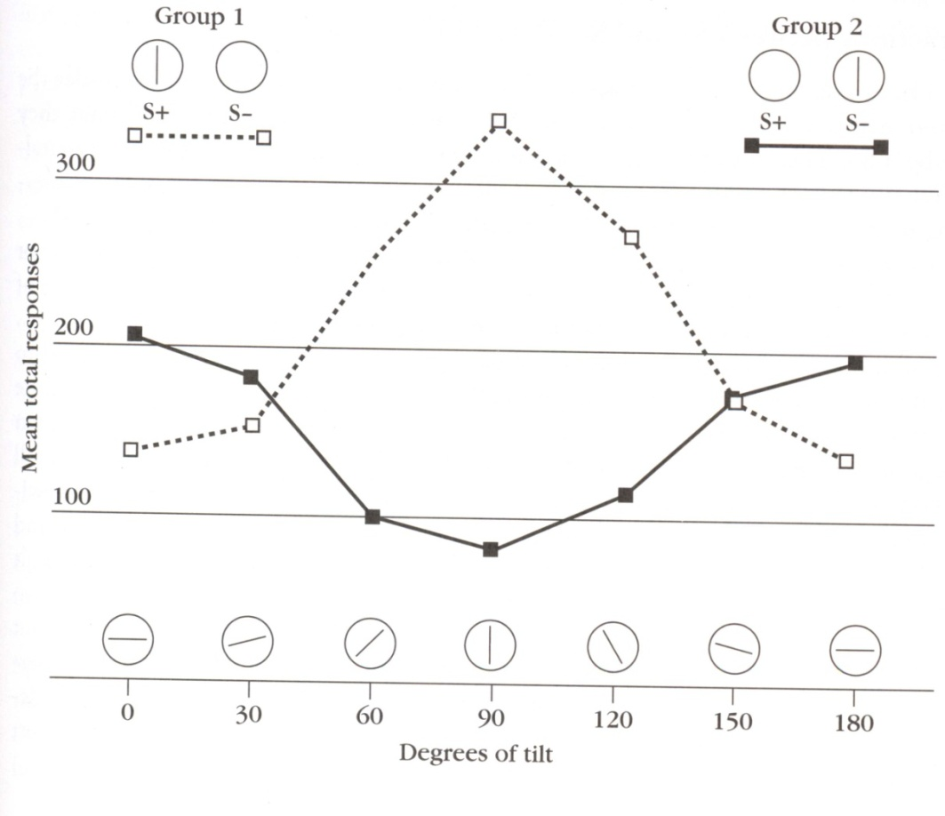
Testing Spence
Honig, et al. (1963): two groups of pigeons received discrimination training with visual stimuli before tests of stimulus generalization
One group reinforced for pecking when the key was illuminated by a white light with a black vertical bar (S+)
  Not reinforced when just light (S-)
The second group received the same stimuli—switched
After both groups had learned to respond more to S+ than S-, tests of stimulus generalization
Notes:
In a landmark experiment, two groups of pigeons received discrimination training with visual stimuli before tests of stimulus generalization (Honig, et al., 1963). One group was reinforced for pecking when the response key was illuminated by a white light with a black vertical bar (S+)
They were not reinforced when just the light was presented
The second group received the same stimuli—only the roles were switched (white light with black bar was S- and white light alone was S+)
After both groups had learned to respond more to S+ than S-, tests of stimulus generalization were conducted to see how much control the vertical bar has gained of behavior both groups
That test was presentation of bars at various levels of tilt

Slide 20
Spence’s theory of discrimination learning
Group 1 (S+ vertical bar): highest rate of responding when bar presented in original vertical position
  Excitatory stim generalization gradient
Group 2 (S- vertical bar): did not peck when vertical bar was present, progressively less inhibition of pecking as bar tilted
  Inhibitory stim generalization gradient
Discrimination training can produce both excitatory and inhibitory conditioning
Strong support for Spence’s theory of discrimination learning
Notes:
Group 1 (S+ vertical bar): came to respond in presence of vertical bar—during generalization test, highest rate of responding when bar presented in original vertical position
Progressively less responding as bar was tilted more and more away from vertical
These results illustrate an excitatory stim gen gradient
Group 2 (S- vertical bar): did not peck when vertical bar was present—during generalization test, failure to respond was due to active inhibition of pecking in response to the position of the vertical bar
As the bar was tilted away from original vertical position, progressively less inhibition of pecking was seen
These results illustrate an inhibitory stim gen gradient

Slide 21
Stimulus discrimination
So far assumed that what s’s learn about S+ independent of what s’s learn about S-
Learning is not so neatly compartmentalized.
Especially if S+ and S- are related in some way
E.g., if they differ by one attribute—intradimensional discrimination
Notes:
So far I have described general characteristics of stimulus discrimination training under the assumption that what subjects learn about S+ is pretty much independent of what they learn about S-.
This assumption is too simplistic Learning is not so neatly compartmentalized.
What is learned about S+ can influence the response to S- and vice versa
Such interactions are particularly likely if S+ and S- are related in some way
One way that S+ and S- may be related is if they are similar except for one feature or attribute, we are dealing with—intradimensional discrimination

Slide 22


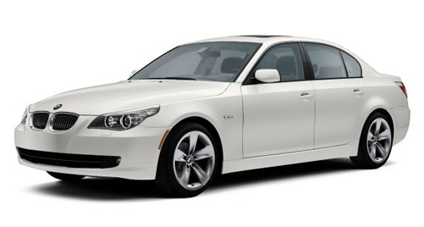
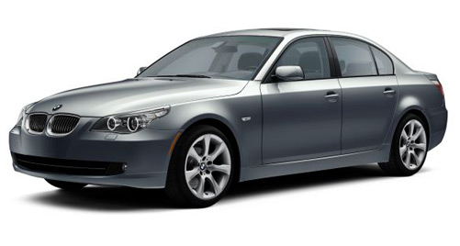
What is intra-dimensional discrimination?
Expert performance
vs
vs
Notes:
Intradimensional discriminations are of particular interest because they are related to the problem of expert performance. Expert performance typically involves making subtle distinctions.
Distinguishing stimuli that differ only in a single feature is more difficult than distinguishing stimuli that differ in many respects
E.g., not much expertise to tell difference between a compact car and a bus
More knowledge to know difference b/w on version of Ford Taurus and another
The fewer distinguishing features, the more difficult the discrimination

Slide 23
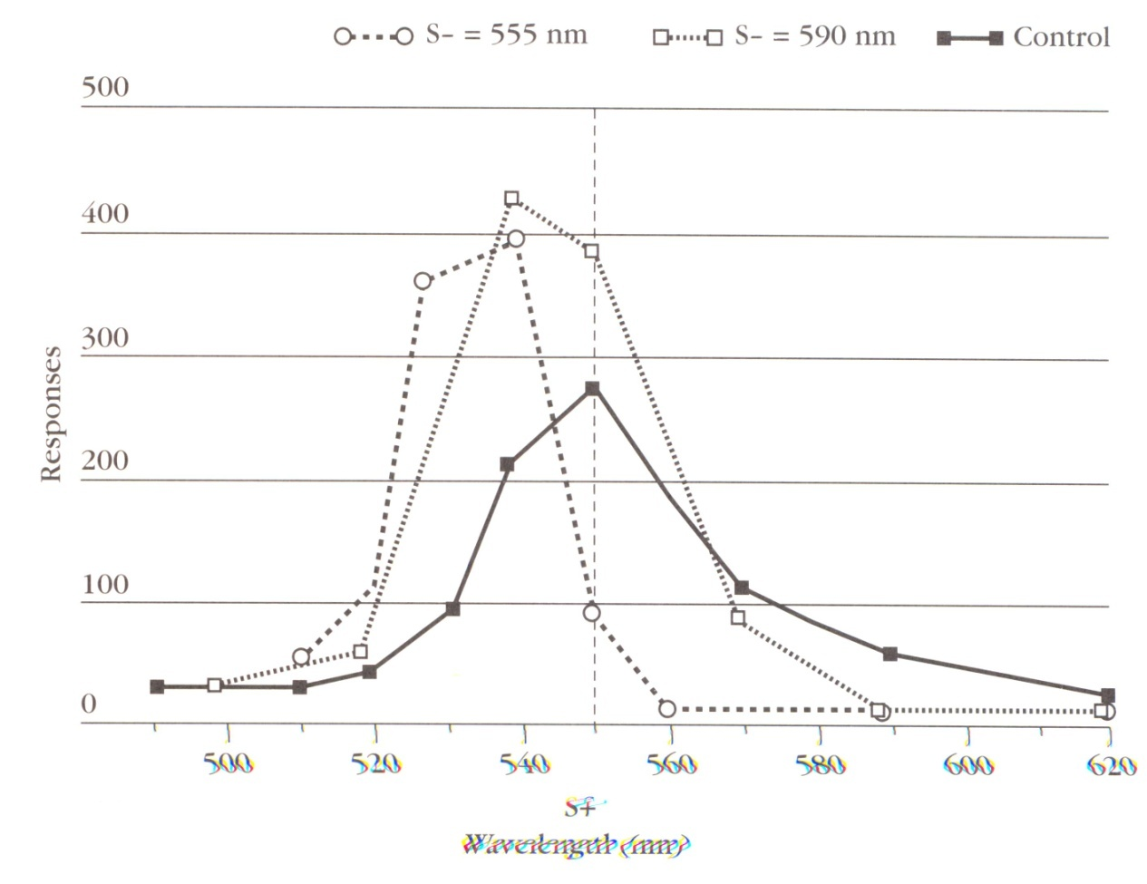
Intra-dimensional discrimination
Hanson (1959)
Hanson (1959): pigeons trained to peck in presence of 550nm lights (all same S+)
3 groups: 590nm (40 nm away) vs. 555nm (5 nm away) vs. control (no S-)
Post test data shown
Control – typical gradient
590nm –more generalization to the 540nm color than to original color
  Shift of peak responding away from original S+
555nm – even more dramatic shift of peak responding away from original S+
Notes:
The importance of intradimensional discrimination learning was illustrated in a landmark experiment by Hanson (1959)
Various colors – pecking behavior
All pigeons trained to peck in presence of 550nm lights (all same S+)
Groups differed in how similar the S- was to the S+ (how expert the pigeons had to become to tell the colors apart)
590nm (40 nm away) vs. 555nm (5 nm away) vs. control (no discrim training—just reinforced for 550nm)
After training, birds tested for rate of pecking in presence of various colored stimuli—see Figure
Control – highest rates of responding to 550nm and progressively lower responding as difference in wavelength increased – typical gradient
590nm – high pecking for 550nm, but showed more generaliztion to the 540nm color than to original color
Shift of peak responding away from original S+
555nm – even more dramatic shift of peak responding away from original S+
540nm and 530nm highest
Shift is remarkable because such colors were never reinforced before!

Slide 24
Peak Shift
A result of intradimensional discrimination training
Depends on the similarity of the S- to the S+ used in discrimination training
  Biggest peak shift when S+ and S- very similar
  Less peak shift as S+ and S- become more different
Can occur for any intradimensional discrimination
  Color, pitch, orientations of lines, loudness, size, positions, etc.
  Robust effect
BUT HOW? Excitatory generalization gradients are supposed to peak at S+
Can the peak shift effect be explained in terms of standard excitatory and inhibitory gradients?
Notes:
. This phenomenon is called the peak-shift phenomenon. The peak-shift effect is a result of intradimensional discrimination training (didn’t occur for controls).
The peak-shift effect was a function of the similarity of the S- to the S+ used in discrimination training
The biggest peak shift occurred when S+ and S- were very similar
Less peak shift as S+ and S- became more different
Can occur for any intradimensional discrimination
Color, pitch, orientations of lines, loudness, size, positions, etc.
Robust effect
How can this be?
Excitatory generalization gradients are supposed to peak at S+
Can the peak shift effect be explained in terms of standard excitatory and inhibitory gradients?

Slide 25
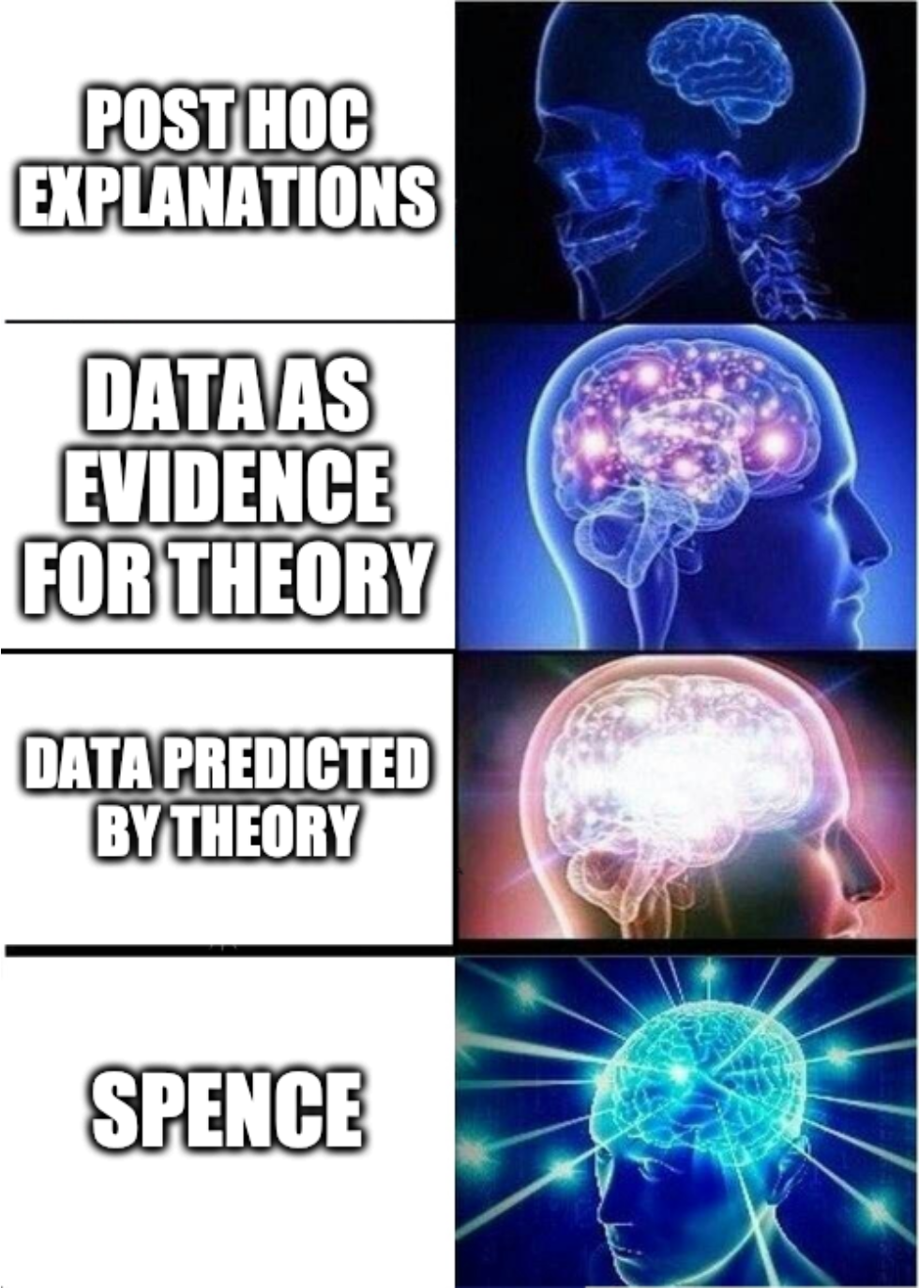
Peak Shift
Spence (1937): excitatory and inhibitory processes might produce peak-shift phenomenon
Because the S+ and S- are similar in intradimensional discrimination, the generalization gradients of excitation and inhibition will overlap
The degree of overlap = degree of similarity
Because of this overlap, generalized inhibition from S- will suppress responding to S+, resulting in a peak shift
More inhibition from S- to S+ will occur if S- is closer to S+, which will produce a greater peak shift
Notes:
Spence (1937) suggested that excitatory and inhibitory processes might produce peak-shift phenomenon. Remarkably, he proposed this idea more than 20 years before the peak-shift effect and gradients of excitation and inhibition were experimentally demonstrated!!!
Spence assumed that because the S+ and S- are similar in intradimensional discrimination task (both colors for example), the generalization gradients of excitation and inhibition will overlap
The degree of overlap will depend on the degree of similarity between S+ and S-
Because of this overlap, generalized inhibition from S- will suppress responding to S+, resulting in a peak shift
More inhibition from S- to S+ will occur if S- is closer to S+--which will produce a greater peak shift

Slide 26
Peak Shift
Even with peak shift, discrim training limits generalization & increases steepness of generalization gradients
This raises questions:
  Are there learning procedures that have the opposite effect?
  Are there learning procedures that increase stimulus generalization?
  How might we construct such procedures?
In a normal discrimination procedure, stimuli are treated differently… what if two stimuli were treated in the same or equivalent fashion?
Equivalence training also encourages generalized responding or stimulus equivalence
Notes:
. The peak-shift effect is a curious and counterintuitive outcome of intradimensional discrimination training. However, even with this effect, discrimination training drastically increases the stimulus control of behavior.
It limits the generalization of behavior from S+ to other cues and increases the steepness of generalization gradients
This raises questions:
Are there learning procedures that have the opposite effect?
Are there learning procedures that increase stimulus generalization?
How might we construct such procedures?
In a normal discrimination procedure, stimuli are treated differently—they have different consequences—one is associated with reinforcement, the other is not. This leads to differential responding, of course.
What would happen if two stimuli were treated in the same or equivalent fashion?
Would such a procedure lead organism to respond to the stimuli as similar/equivalent?
The answer seems to be yes. Equivalence training encourages generalized responding or stimulus equivalence

Slide 27


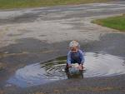
Can we train “equivalence”?
Pigeons can be trained to respond in a similar fashion to different photographs, all of which include water in some form (ocean, lake, puddle, stream).
The basic training strategy is to reinforce the same response (pecking) in the presence of pictures with water, and not reinforce the response in the presence of pictures without water
Herrnstein et al (1976) trained such a discrimination with 500-700 photos of scenes in New England
Once learned the water/no water discrimination, the pigeons behaviors generalized to novel photographs that had not been presented during training
Sound like anyone?
Notes:
Several approaches are available to promote generalization among stimuli. For example, pigeons can be trained to respond in a similar fashion to different photographs, all of which include water in some form (ocean, lake, puddle, stream).
The basic training strategy is to reinforce the same response (pecking) in the presence of pictures with water, and not reinforce the response in the presence of pictures without water
Herrnstein et al (1976) trained such a discrimination with 500-700 photos of scenes in New England
Once learned the water/no water discrimination, the pigeons behaviors generalized to novel photographs that had not been presented during training

Slide 28
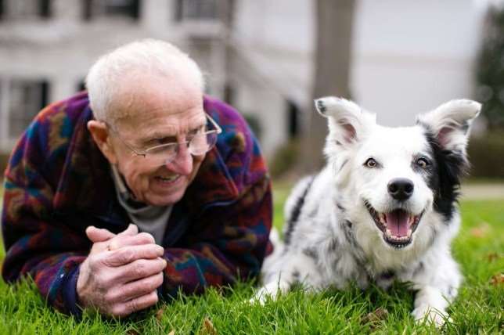
Notes:
Dr. John Pilley and Chaser
Trained 4-5 hrs a day using “fast mapping” techniques

