Slide 1

PSYCH 2202 – The Psychology Major
M/W 2:00-2:50 pm
January to May 2020 in STEM 231A
COVID-19 ONLINE DELIVERY
Instructor: Dr. Mario Baldassari mbaldassari@tamusa.edu, @MarioBaldassari
Office hours Tues 2-3pm & 5-6pm, Fri 9-11am in STEM 237E (or by appt)
Please make an appointment ahead of time if you plan to visit office hours.

Slide 2
Date | Topic (reading) | Due | Also Due
23-Mar | Bem discussion, using memory research | Bem reflection | Upload your presentation paper
30-Mar | A&M Degree plan advice, career services
6-Apr | No lecture, spend week watching presentations | Article presentation slides, audio, questions
13-Apr | Simmons et al (2011) | Presentation quiz | Reflection 2
20-Apr | Problems in Psych (NYT & 538 PDF's)
27-Apr | Myths about working with a psych degree | Your future presentation slides, audio, questions
11-May | Final exam date | Presentation quiz, Final Reflection Paper, take final exam

Slide 3
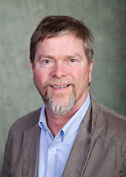
Learning Outcomes
By the end of today, you will be able to:
  Describe the networked nature of memory
  Use the study methods we outline to learn course material more deeply and retain it longer
  Shout out to Dr. Steve Lindsay, who created parts of this presentation

Slide 4
Define “Memory”
Memory is the faculty of the mind by which information is encoded, stored, and retrieved (Atkinson & Shiffrin, 1968).
Notes:
Who feels like they have a pretty good memory?

Slide 5
The Constructive Nature of Memory
Memory depends on:
  What actually happened
  plus
  Person’s knowledge, experiences, and expectations (CONTEXT)
  Memory is not replayed like a video, but reconstructed based on multiple pieces of information

Slide 6

Notes:
Memory is not like a video camera, it’s more like wikipedia. You can look up an article and it will link you to all the relevant articles, like how remembering the last movie you saw might lead you to remember a movie like it or the movie you saw before that and who was in the movie and so on.

Slide 7
How do you study?

Slide 8
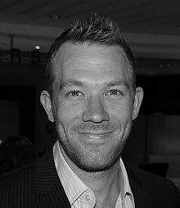
Mnemonics
Methods for intentional memorization (e.g., shopping list, names, capitals).
Mnēmonikos
Nelson Dellis, mnemonist or
memory athlete; can memorize
a deck of cards in a couple of minutes.
Dellis Lecture: https://www.youtube.com/watch?v=pXYqnEwFohI
Notes:
Mnemonikos means “of memory” or “remembering”

Slide 9
See what you can do: Memorize the following words in order.

Slide 10
Bicycle
Cow
Fence
Computer
Acorn
Shoe
Nose
Cake
Water
Lion
Tuxedo
Onion
Comb
Halo
Notes:
Long study, so compares to loci demo

Slide 11
Recall what you can.

Slide 12
Bicycle
Cow
Fence
Computer
Acorn
Shoe
Nose
Cake
Water
Lion
Tuxedo
Onion
Comb
Halo
How many did you remember?
<5
5-9
9+
All

Slide 13
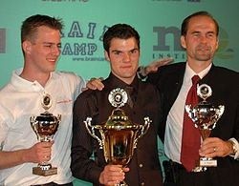
Memory athletes such as Nelson Dellis or Clemens Mayer (middle) can listen to a random list of hundreds of words presented at a 1-s rate and recall them in order.
Had +/- average memories before they began training.

Slide 14
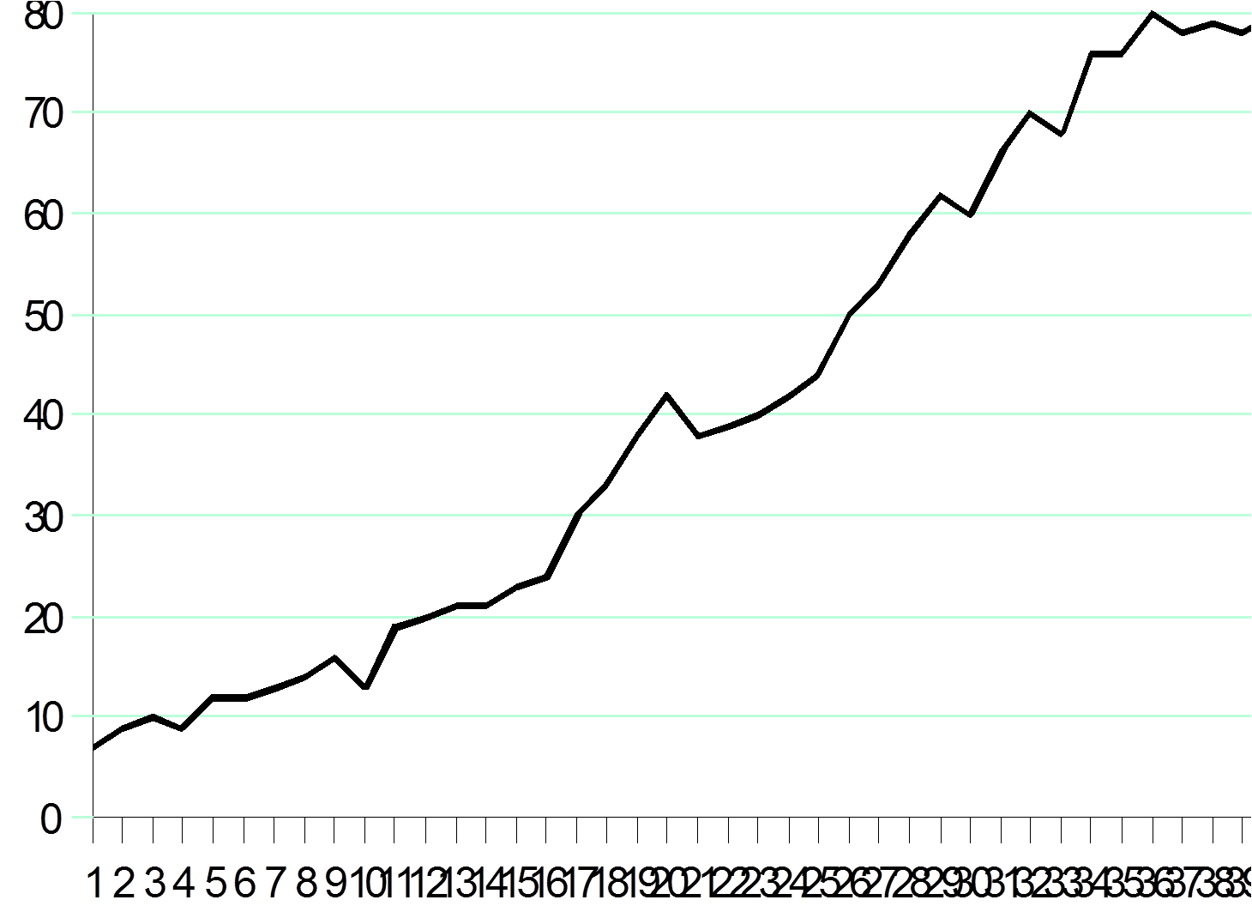
Steve Falloon’s digit span went from 8 to 80 with practice/strategy.

Slide 15

Notes:
LiveSlide Site
https://www.youtube.com/watch?v=0FSKTndbwVo
Sherlock mind palace

Slide 16
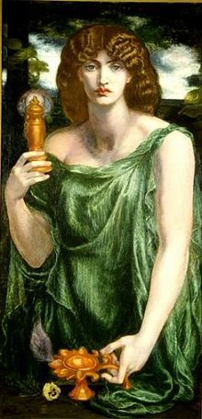
Method of Loci (aka Memory Palace)
Developed by ancient Greeks.
1. Select a highly familiar pathway that has a large number of salient landmarks (e.g., a tour of your childhood home from basement door to attic). Over a period of days or weeks, utterly master that pathway, landmark by landmark, rock solid.
2. To memorize list, form vivid, distinctive multi-sensory image of first item interacting with first landmark of your pathway. Then form image of second item interacting with second landmark, etc.
3. To recall, mentally traverse the pathway.
Mnemoscene, goddess of memory
(Rossetti)
Notes:
Let’s try it, but as a shortcut we’ll use locations in this room

Slide 17
Notes:
LiveSlide Site
https://www.youtube.com/watch?v=dcVmg5_qKlE
Dellis teaches Bill Weir to memorize a deck of cards

Slide 19
Giraffe
Foot
Harp
Apple
Couch
Rope
School
Television
Rose
Cup
Robin
Steak
Sombrero
Judge
Notes:
Giraffe with human feet, using toes to play harp
Apple tied down to a couch with really thick, splintery rope as if its being interrogated
Your grade school on a really old television, when suddenly someone grabs a rose from a cup on top of the tv
A robin eating a steak wearing a huge sombrero with a big powdered wig judge starting down at him

Slide 20
Recall what you can.

Slide 21
Giraffe
Foot
Harp
Apple
Couch
Rope
School
Television
Rose
Cup
Robin
Steak
Sombrero
Judge
How many did you remember?
<5
5-9
9+
All
Notes:
Giraffe with human feet, using toes to play harp
Apple tied down to a couch with really thick, splintery rope as if its being interrogated
Your grade school on a really old television, when suddenly someone grabs a rose from a cup on top of the tv
A robin eating a steak wearing a huge sombrero with a big powdered wig judge starting down at him

Slide 22
Compare first list to second.
Try to remember again next week!
Taking advantage of fact that our minds are set up to remember stories and situations, not lists of facts

Slide 23
Your memory is a network
When one node is activated, all the nodes it’s connected to become somewhat active
This is why recognizing your friend is easier than describing their face to someone, telling a story is easier than regurgitating lists
What were you doing three years ago today?
Notes:
Remembering that day requires activating network based on what you probably did, what you usually did last fall
I was at Uvic, probably in my office or in class, maybe collecting data
These networks could fail us if that particular day didn’t fit the typical network mold, or if some other bit of information steered us in the wrong direction (like if we talked about 2016, that happens to be the day I flew back from visiting family in Texas)

Slide 24
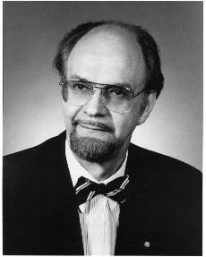
Remembering:
Mental time travelling.
Endel Tulving
Re-membering
Partially re-enacting a prior pattern of brain/mind activity.
Benefits from external cues because processing them naturally causes the mind/brain to partially re-enact a former pattern.
E.g., a perfume or song may mentally transport you.

Slide 25
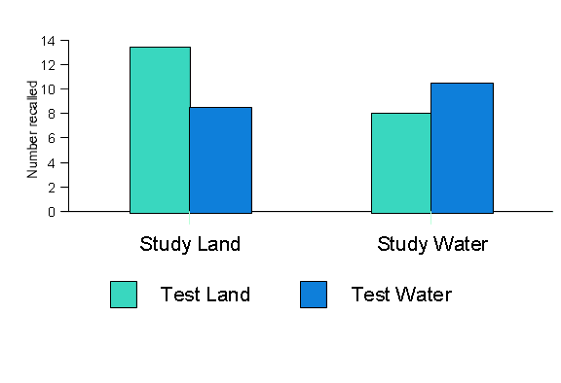
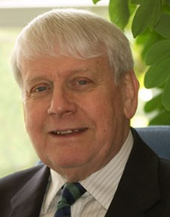
Godden and Baddeley (1975): Some scuba divers studied words on shore, others under water. Later, half of each group was tested on shore, remainder tested under water.
Alan Baddeley

Slide 26
To remember is to make aspects of current pattern of mental activity resemble a prior pattern.
The more uniquely similar the current pattern is to a to-be-remembered pattern, the easier to reconstitute that prior pattern.
Hence being in same room, mood, state, etc., helps.
Especially important if test provides few cues (e.g., short answer rather than MC).

Slide 27
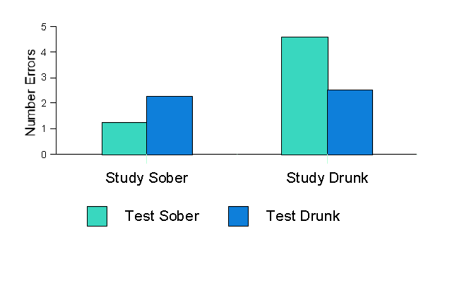
Goodwin et al. (1969) had people study sober or intoxicated and test sober or intoxicated, and measured number of errors.

Slide 28
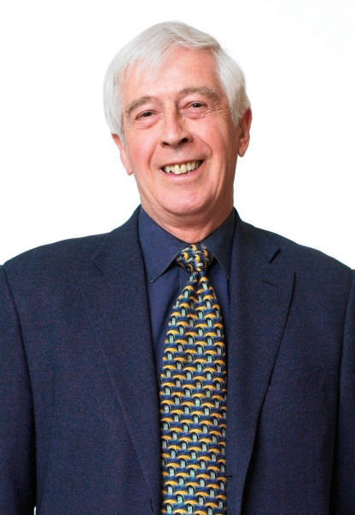
Similar idea:
Fergus Craik’s idea of “Levels of Processing” (LOP)
Encoding operations can be characterized along a continuum for shallow (superficial, stimulus-driven, appearance) to deep (semantic, conceptual, meaningful).
According to LOP, deep processing leads to better memory.
Generally true, but not if test relies on memory for superficial aspects of event (transfer-appropriate processing).

Slide 29
A newspaper is better than a magazine. A seashore is
a better place than the street. At first it is better to run
than to walk. You may have to try several times. It takes
some skill but is easy to learn. Even young children can
enjoy it. Once successful, complications are minimal.
Birds seldom get too close. Rain, however, soaks in very
fast. Too many people doing the same thing can also
cause problems. One needs lots of room. If there are no
Complications, it can be very peaceful. A rock will serve
as an anchor. If things break loose from it, however, you
will not get a second chance.
Notes:
Flying a Kite

Slide 30
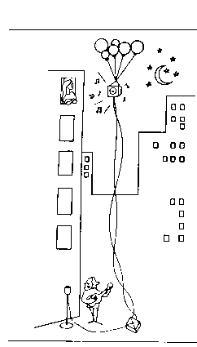
Notes:
If the balloons popped, the sound wouldn’t carry since everything would be too far away from the correct floor. A closed window would also prevent the sound from carrying since most buildings tend to be well insulated. Since the whole operation depends on a steady flow of electricity, a break in the middle of the wire would also cause trouble. Of course, the fellow could shout, but the human voice is not loud enough to carry that far. Another problem is that a string could break on the instrument, and there would be no accompaniment to the message. It is clear that the best situation would involve less distance. Then there would be fewer potential problems. With face to face contact, fewer things could go wrong.

Slide 31
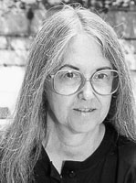
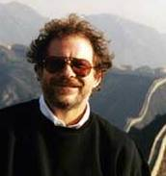
Johnson and Bransford
If the balloons popped, the sound wouldn’t carry since everything would be too far away from the correct floor. A closed window would also prevent the sound from carrying since most buildings tend to be well insulated. Since the whole operation depends on a steady flow of electricity, a break in the middle of the wire would also cause trouble. Of course, the fellow could shout, but the human voice is not loud enough to carry that far. Another problem is that a string could break on the instrument, and there would be no accompaniment to the message. It is clear that the best situation would involve less distance. Then there would be fewer potential problems. With face to face contact, fewer things could go wrong.

Slide 32
Another feature of the network:
Connecting to-be-learned material to things you already know well (a) supports rich, deep, elaborative encoding and (b) provides multiple structures for retrieval.
If you don’t understand the material, likely difficult to recall it.

Slide 33
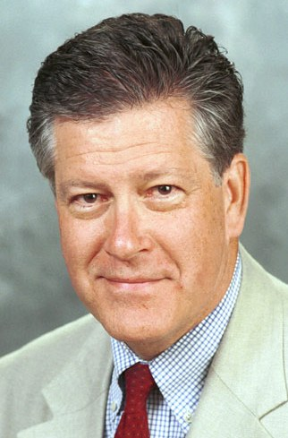
Testing is a powerful way of learning.
Henry “Roddy” Roediger

Slide 34
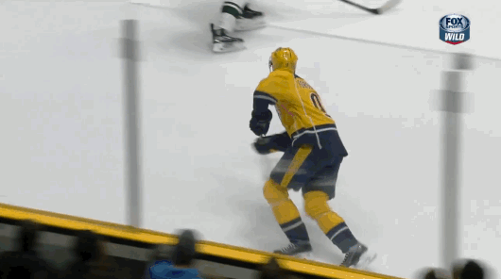
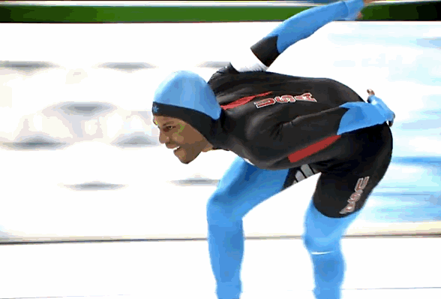
Notes:
Studying by reading and re-reading would be like speed skating to prepare for hockey
You’d get somewhat better, but it really wouldn’t get you all the skills you need
Gotta actually play the game

Slide 35
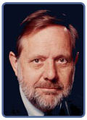
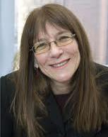
Testing is a powerful way of learning.
Desirable difficulties
promote recall.
Roddy Roediger
Work your “region of proximal learning.”
Janet Metcalfe
Bob Bjork

Slide 36
Summary
Practice how you will be tested
  Practice tests
  Getting yourself to produce knowledge
Deep and distinctive processing -> Understanding.
Imagery
  Build a story
Linking to things you know well
  Try drawing a concept map
  Generate your own examples
Spacing study episodes
Studying in different ways/places – generalize learning and escape from TAP
http://www.nelsondellis.com/techniques/
Notes:
Spacing study episodes is called “distributed practice”, which outperformed massed practice or cramming in memory studies, like we discussed w Ebbinghaus
Spacing out your study enables some study sessions to remind you of others, many sessions of which will improve the strength of the memory overall (also possible that you are more likely to spread out ways/places of studying when distributing practice)

Slide 37
See tweet thread of many of today’s points @MarioBaldassari
https://www.the-learning-agency-lab.com/the-learning-curve/how-to-study-more-effectively

